Slide 1
Itroduction To Helm

Slide 2
If Kubernetes is the operating system of the internet,
then Helm is a package manager for that

Slide 3
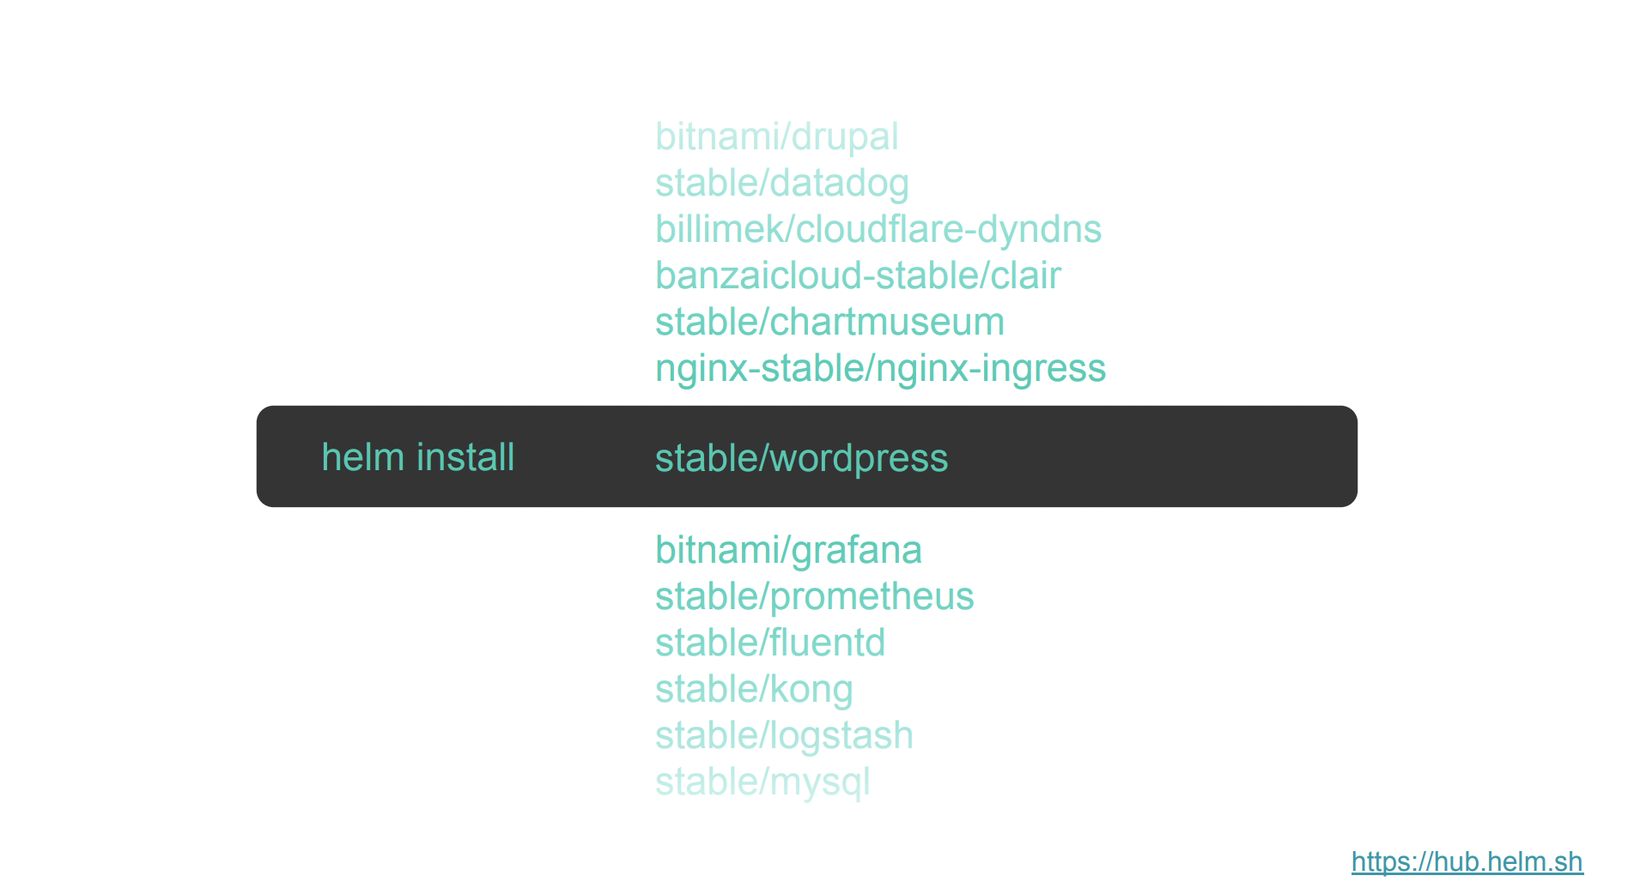

Slide 4
What is Helm?

Slide 5
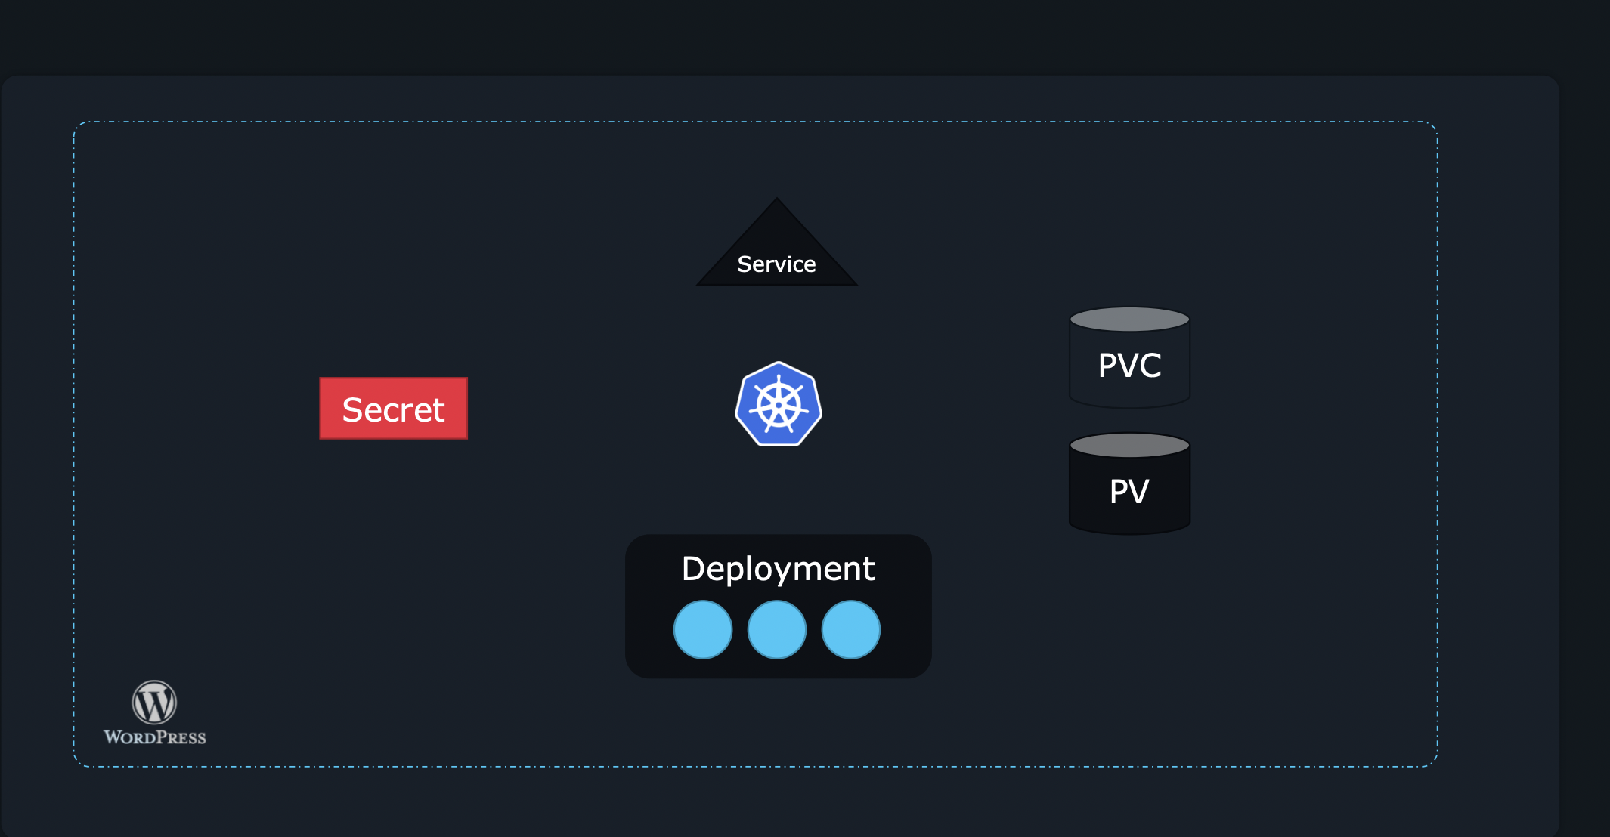
Normal WordPress App Depenecies in K8s chaleenge

Slide 6
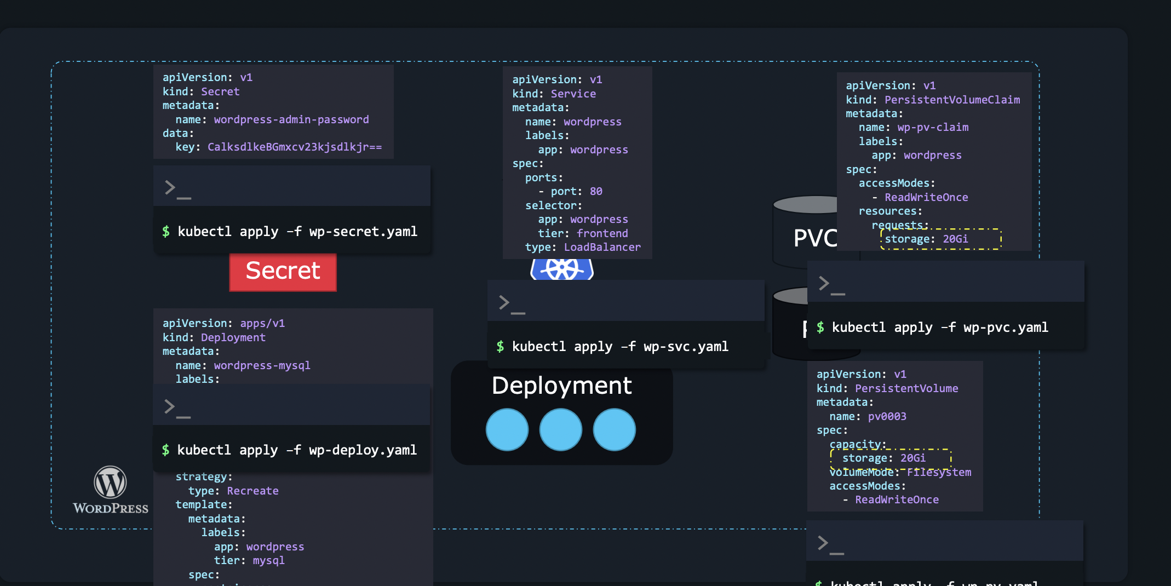

Slide 7
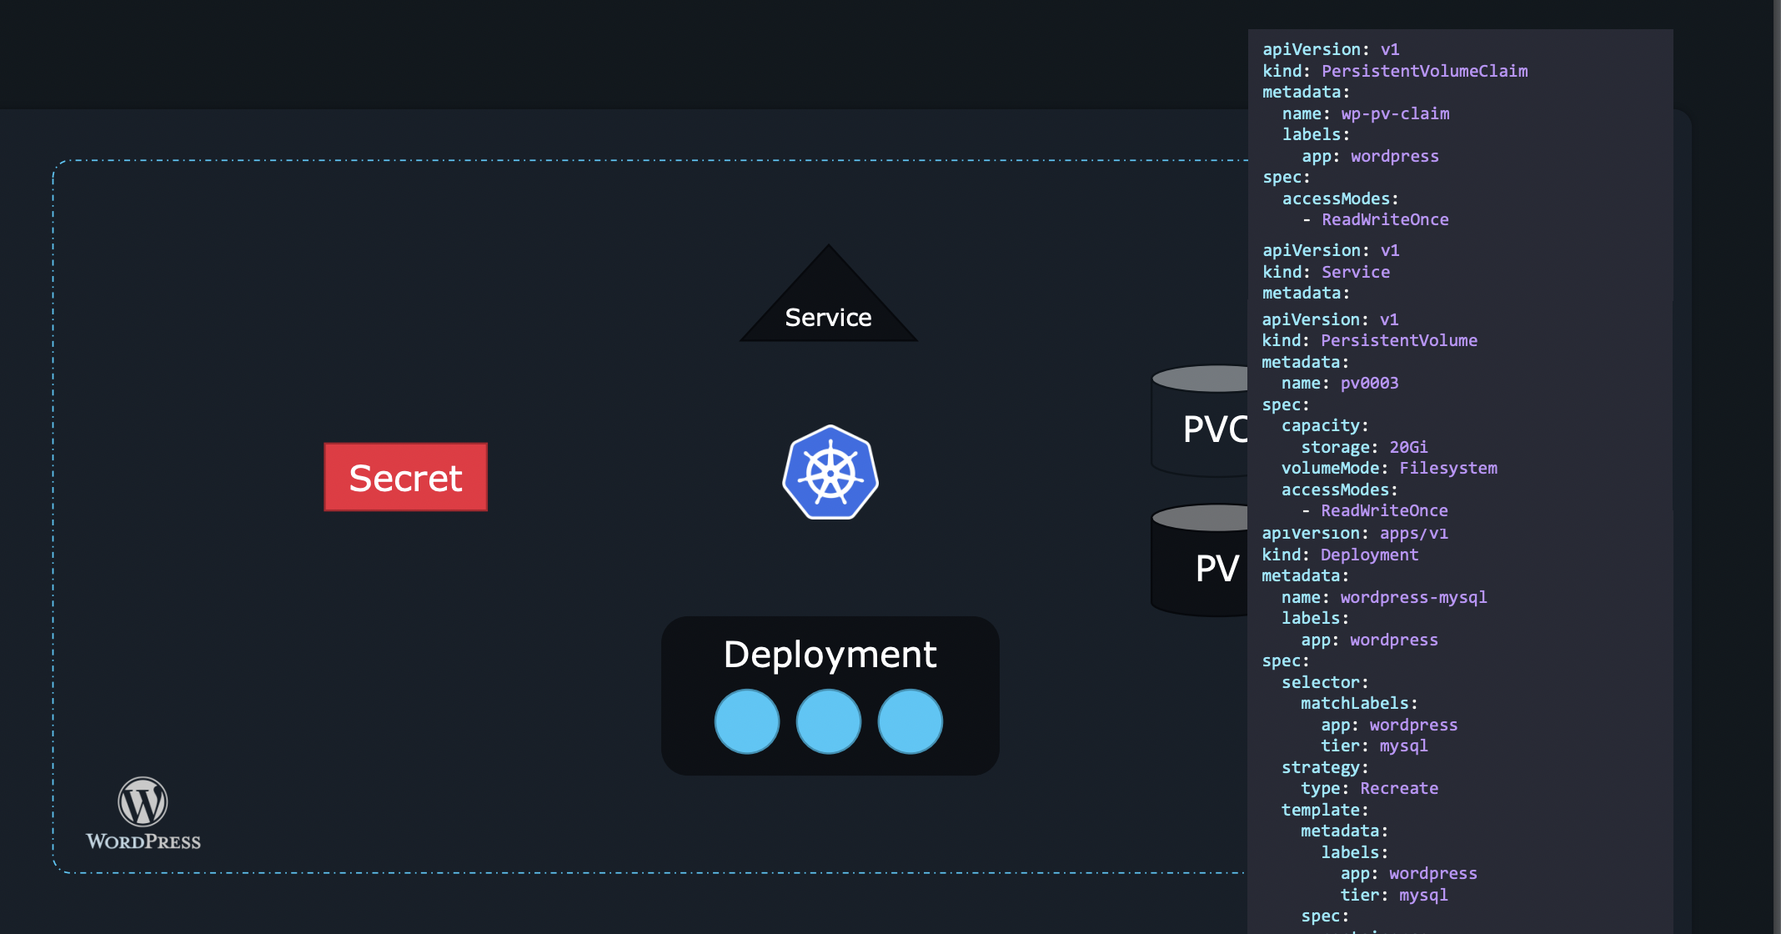

Slide 8
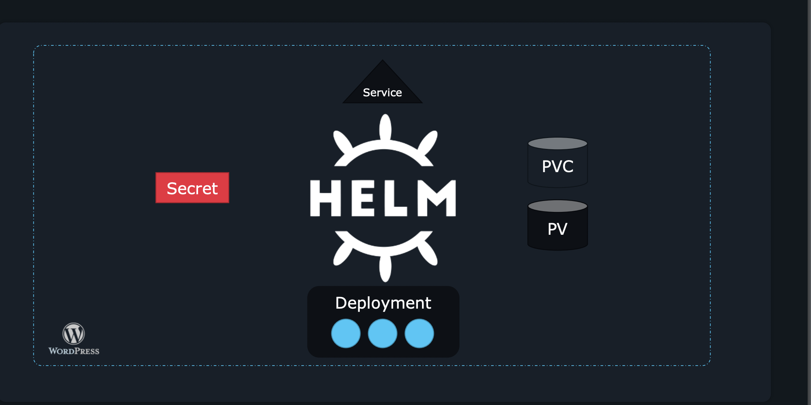
Here we solved the problem using Helm

Slide 9

1 APP

Slide 10
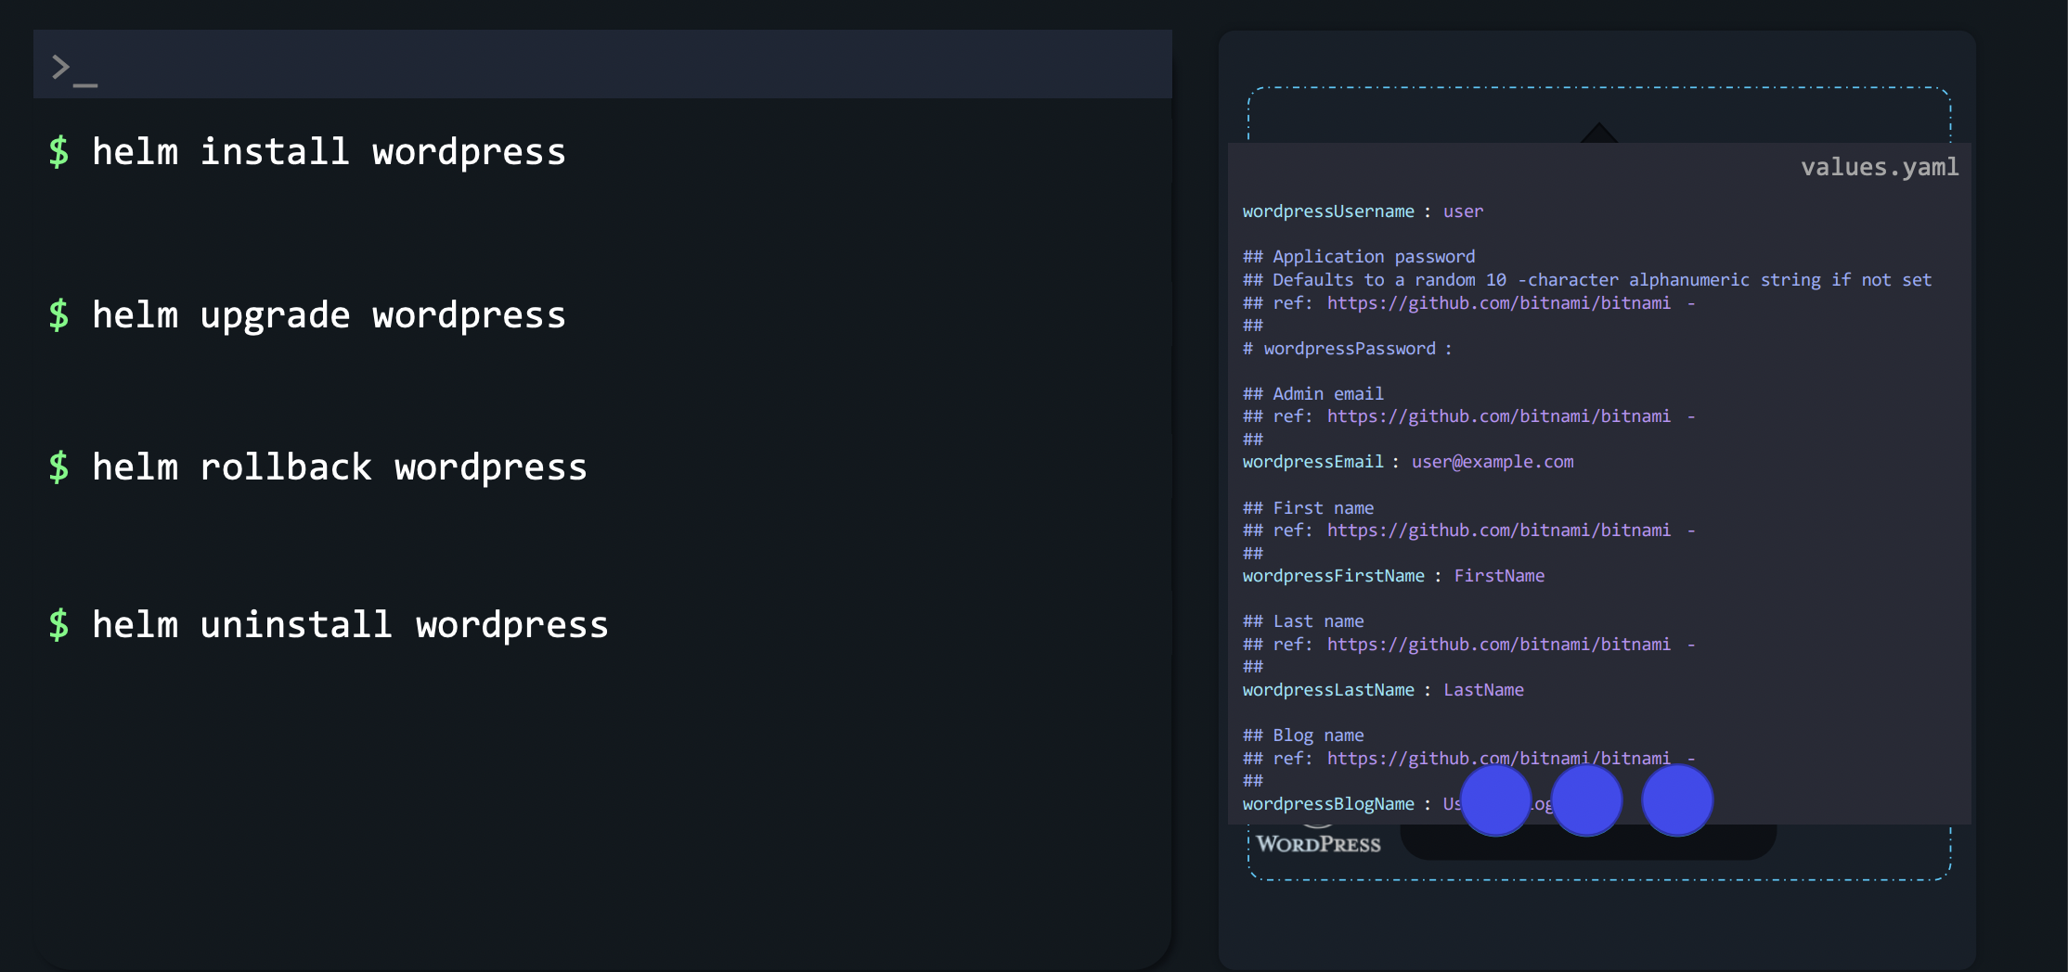

Slide 11
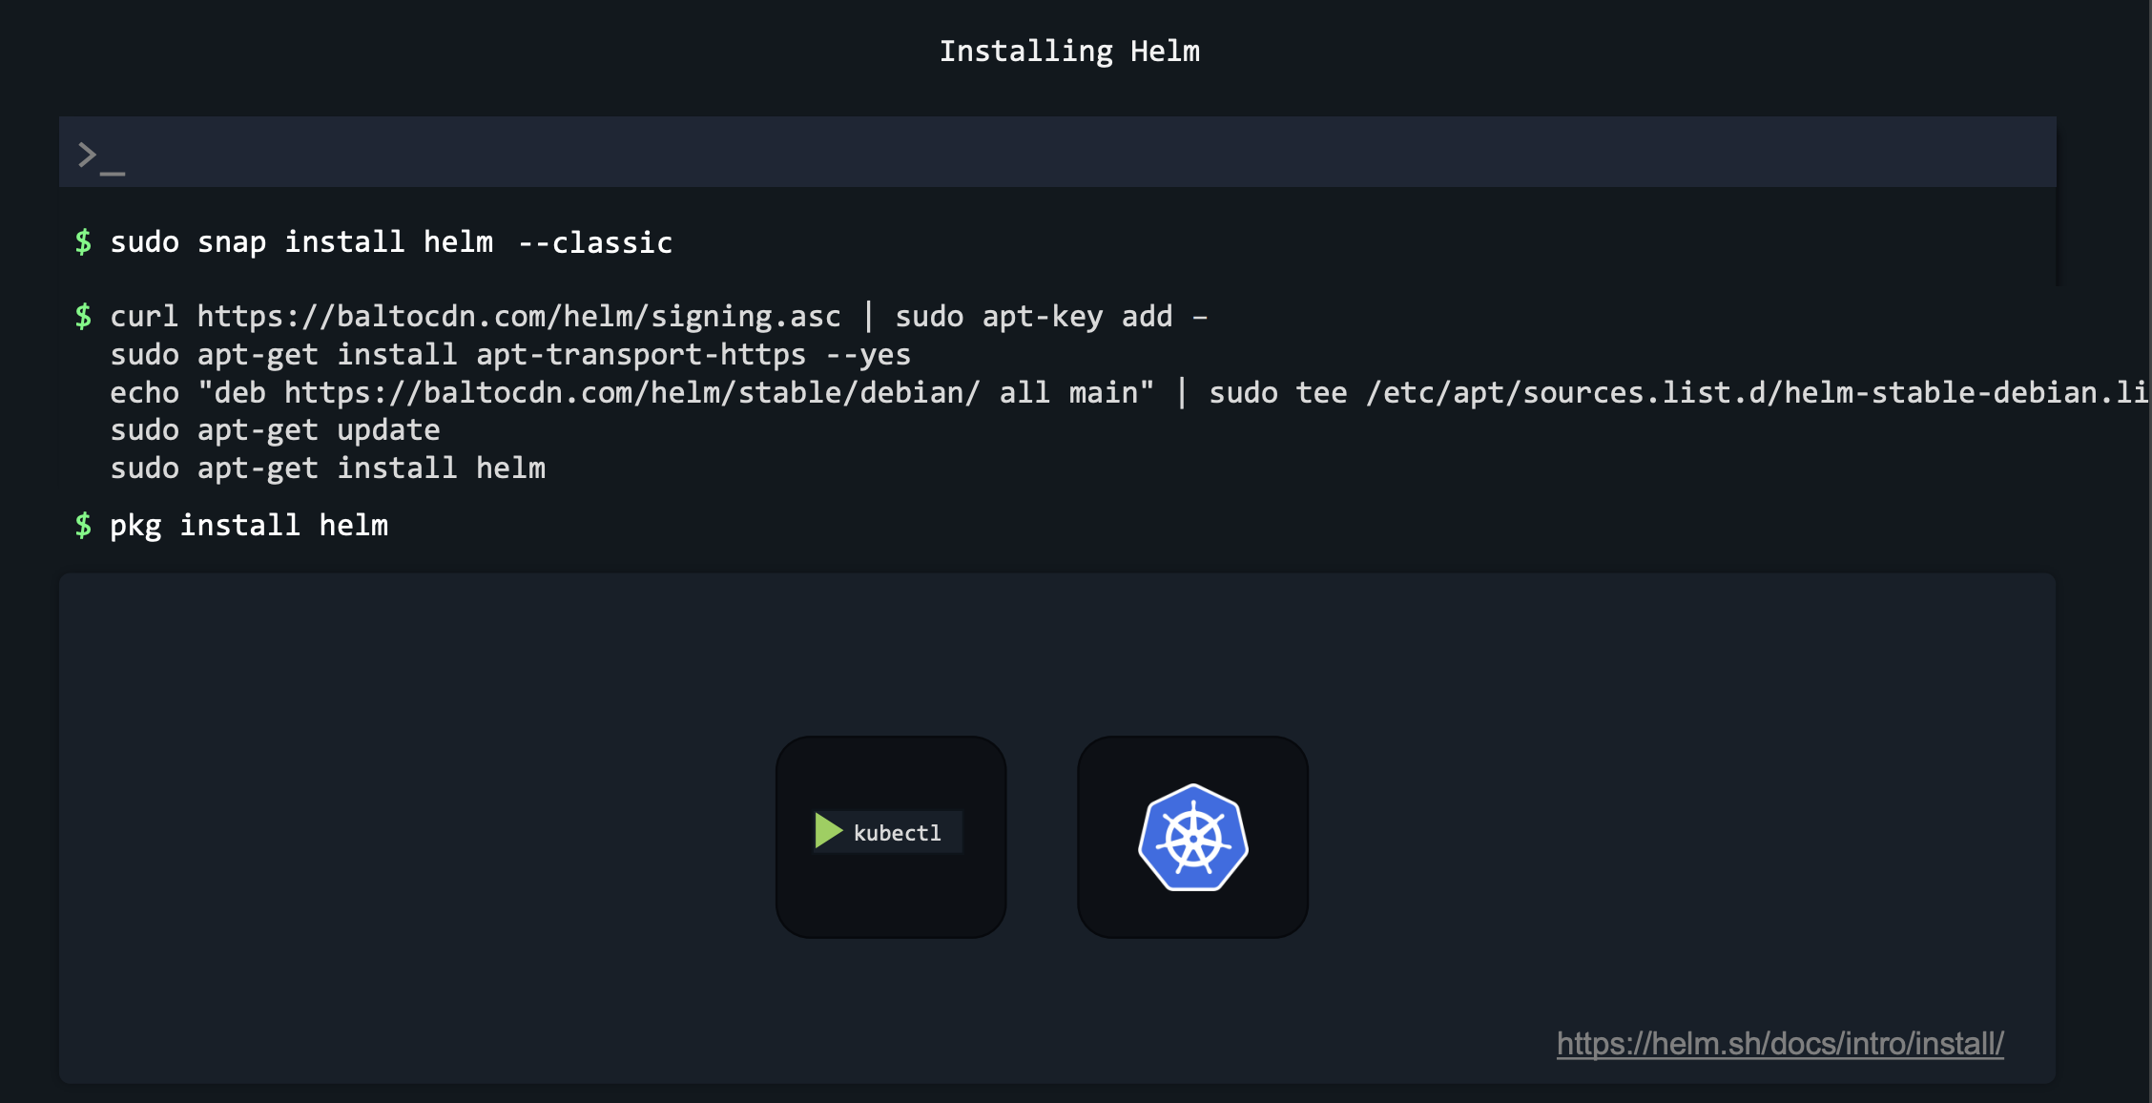
Installing HELM

Slide 12
HELM 2 VS HELM3

Slide 13
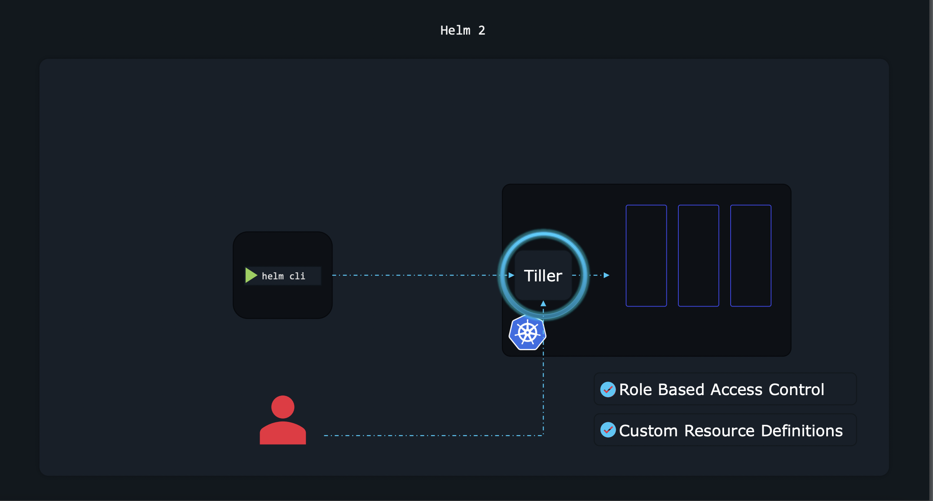

Slide 14
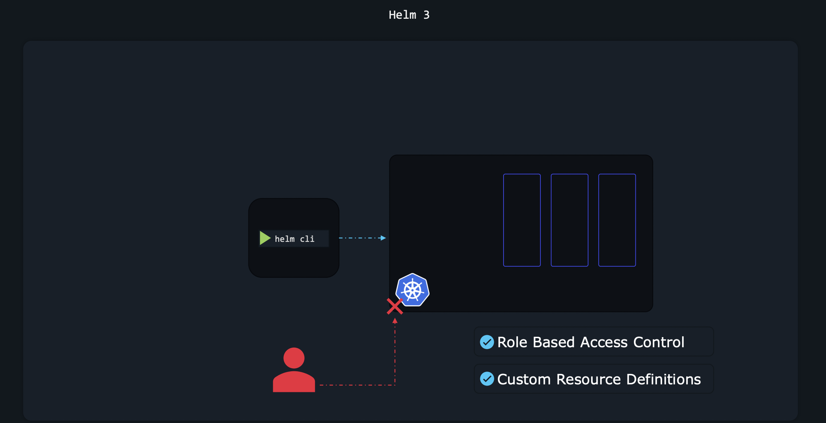

Slide 15
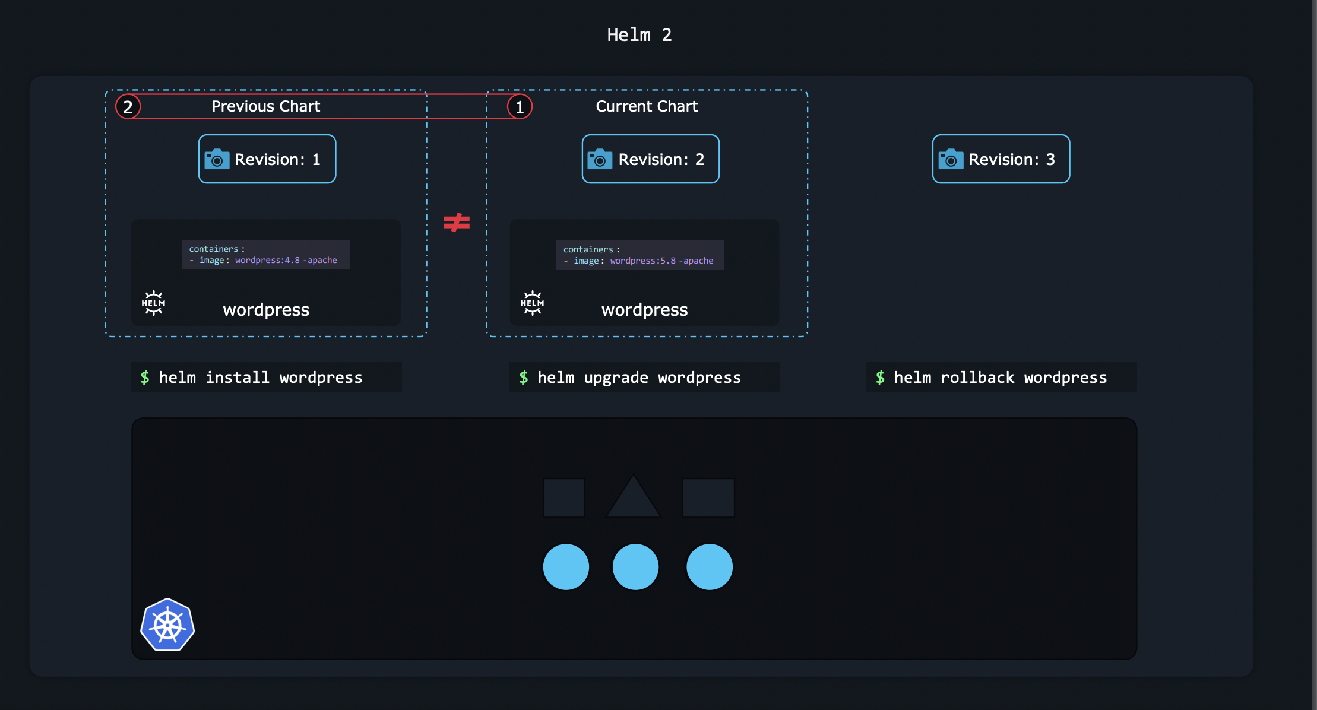

Slide 16
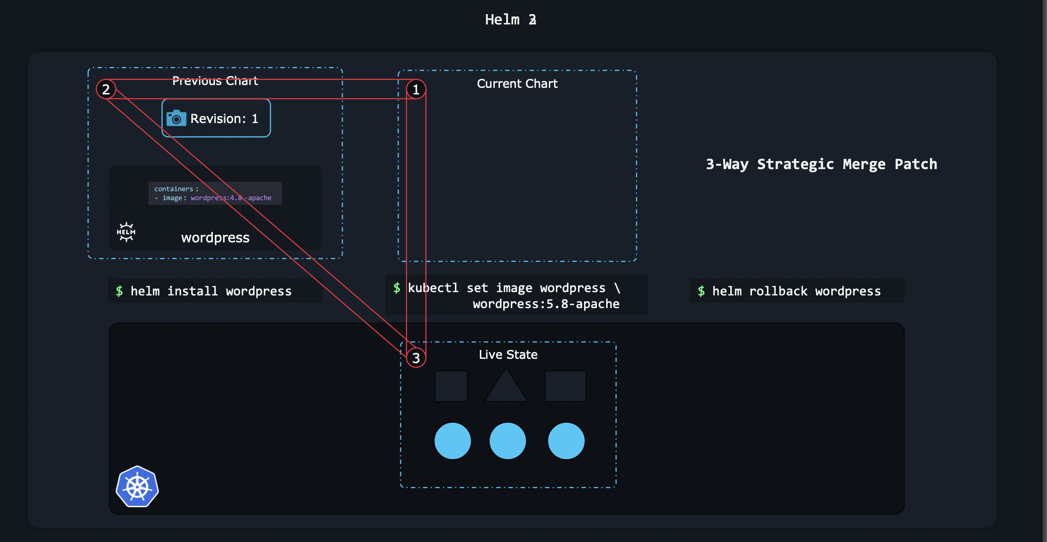

Slide 17
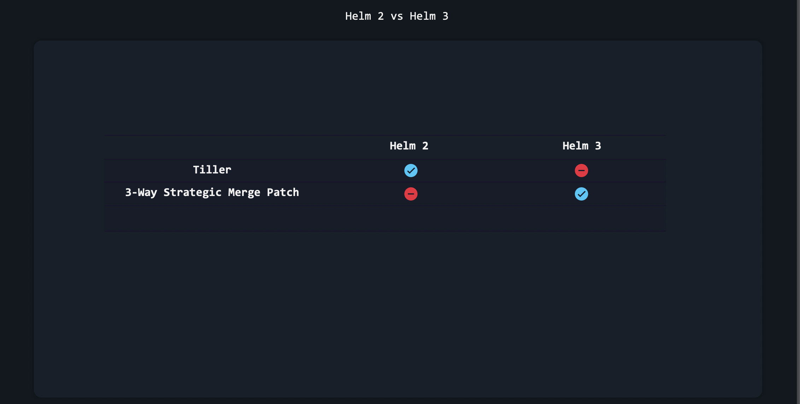

Slide 18
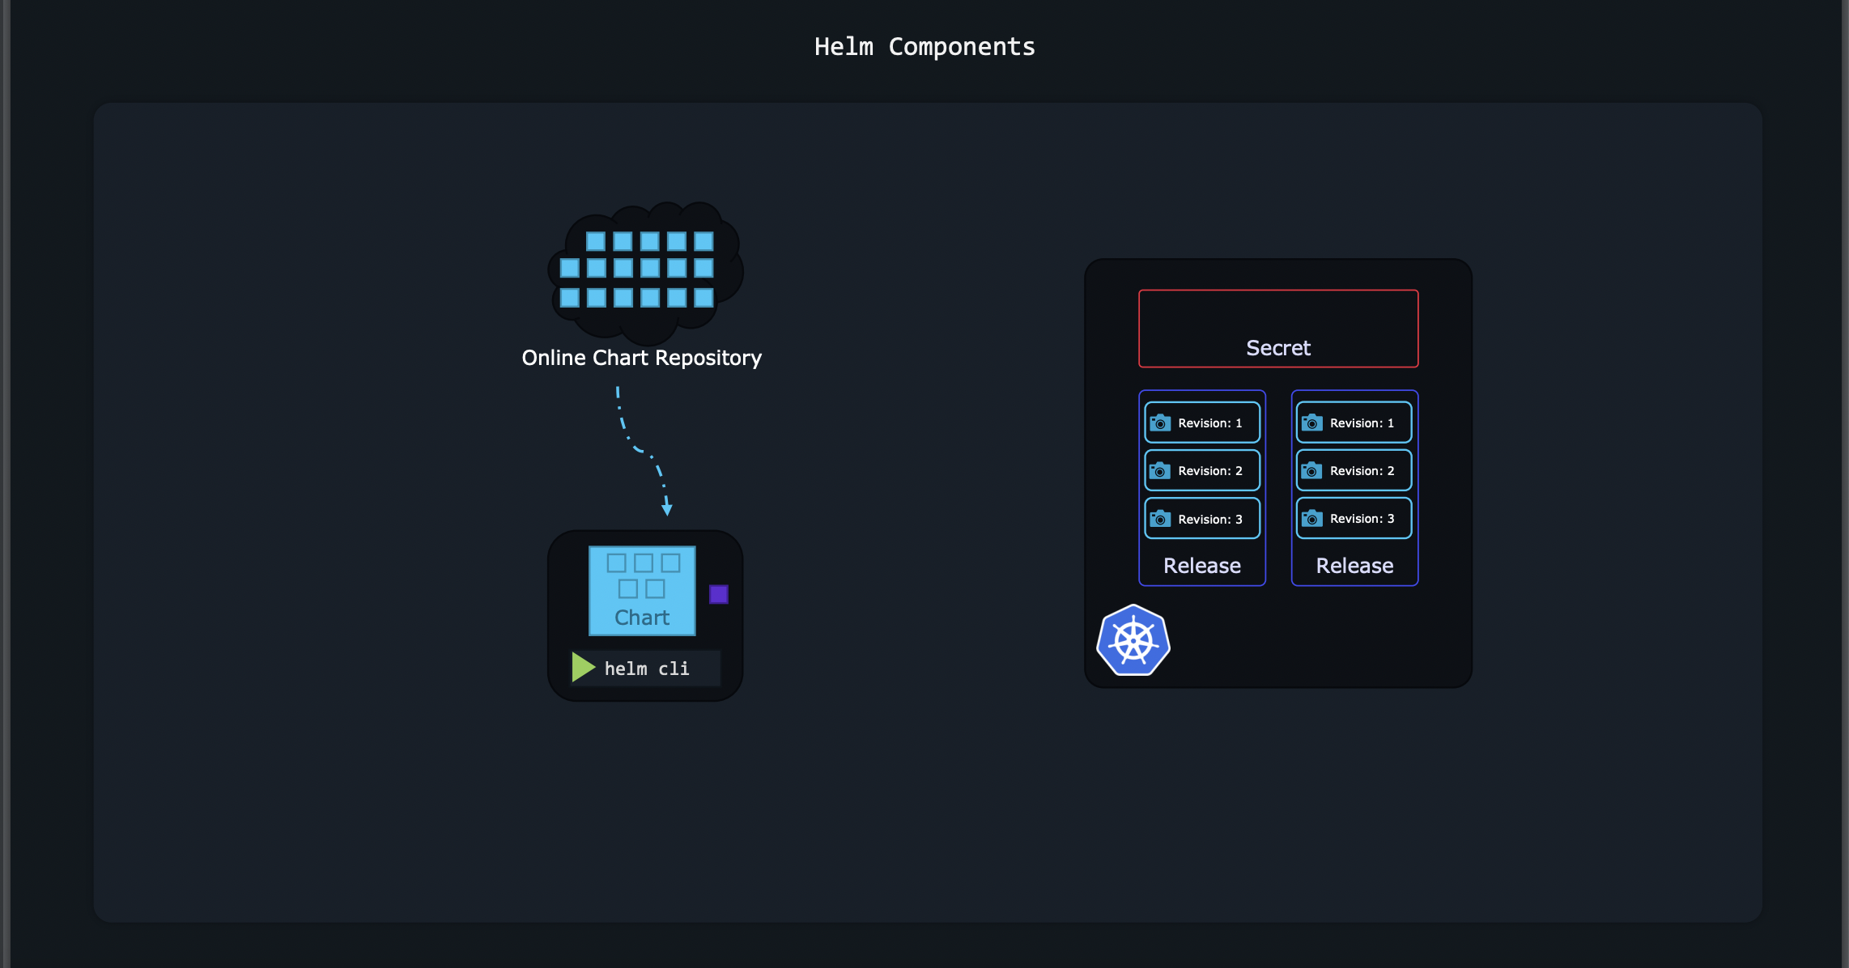

Slide 19
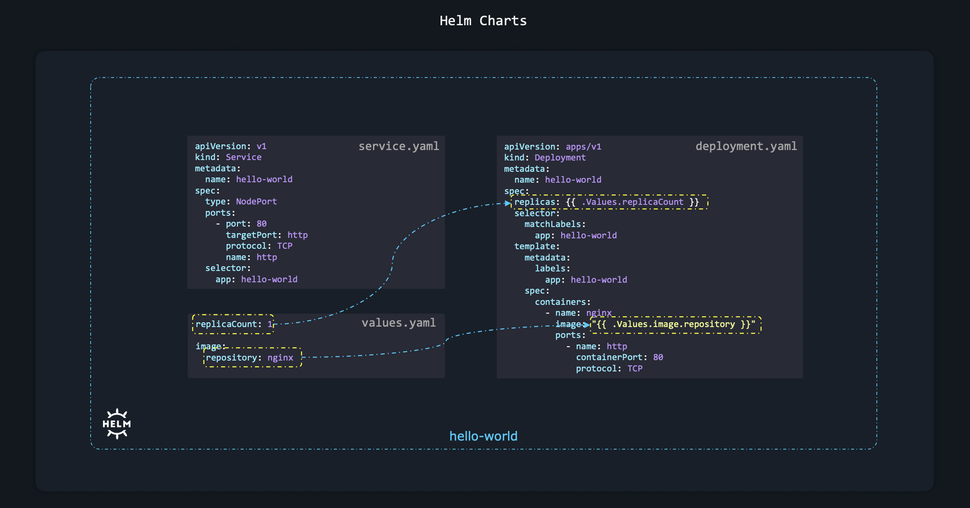

Slide 20
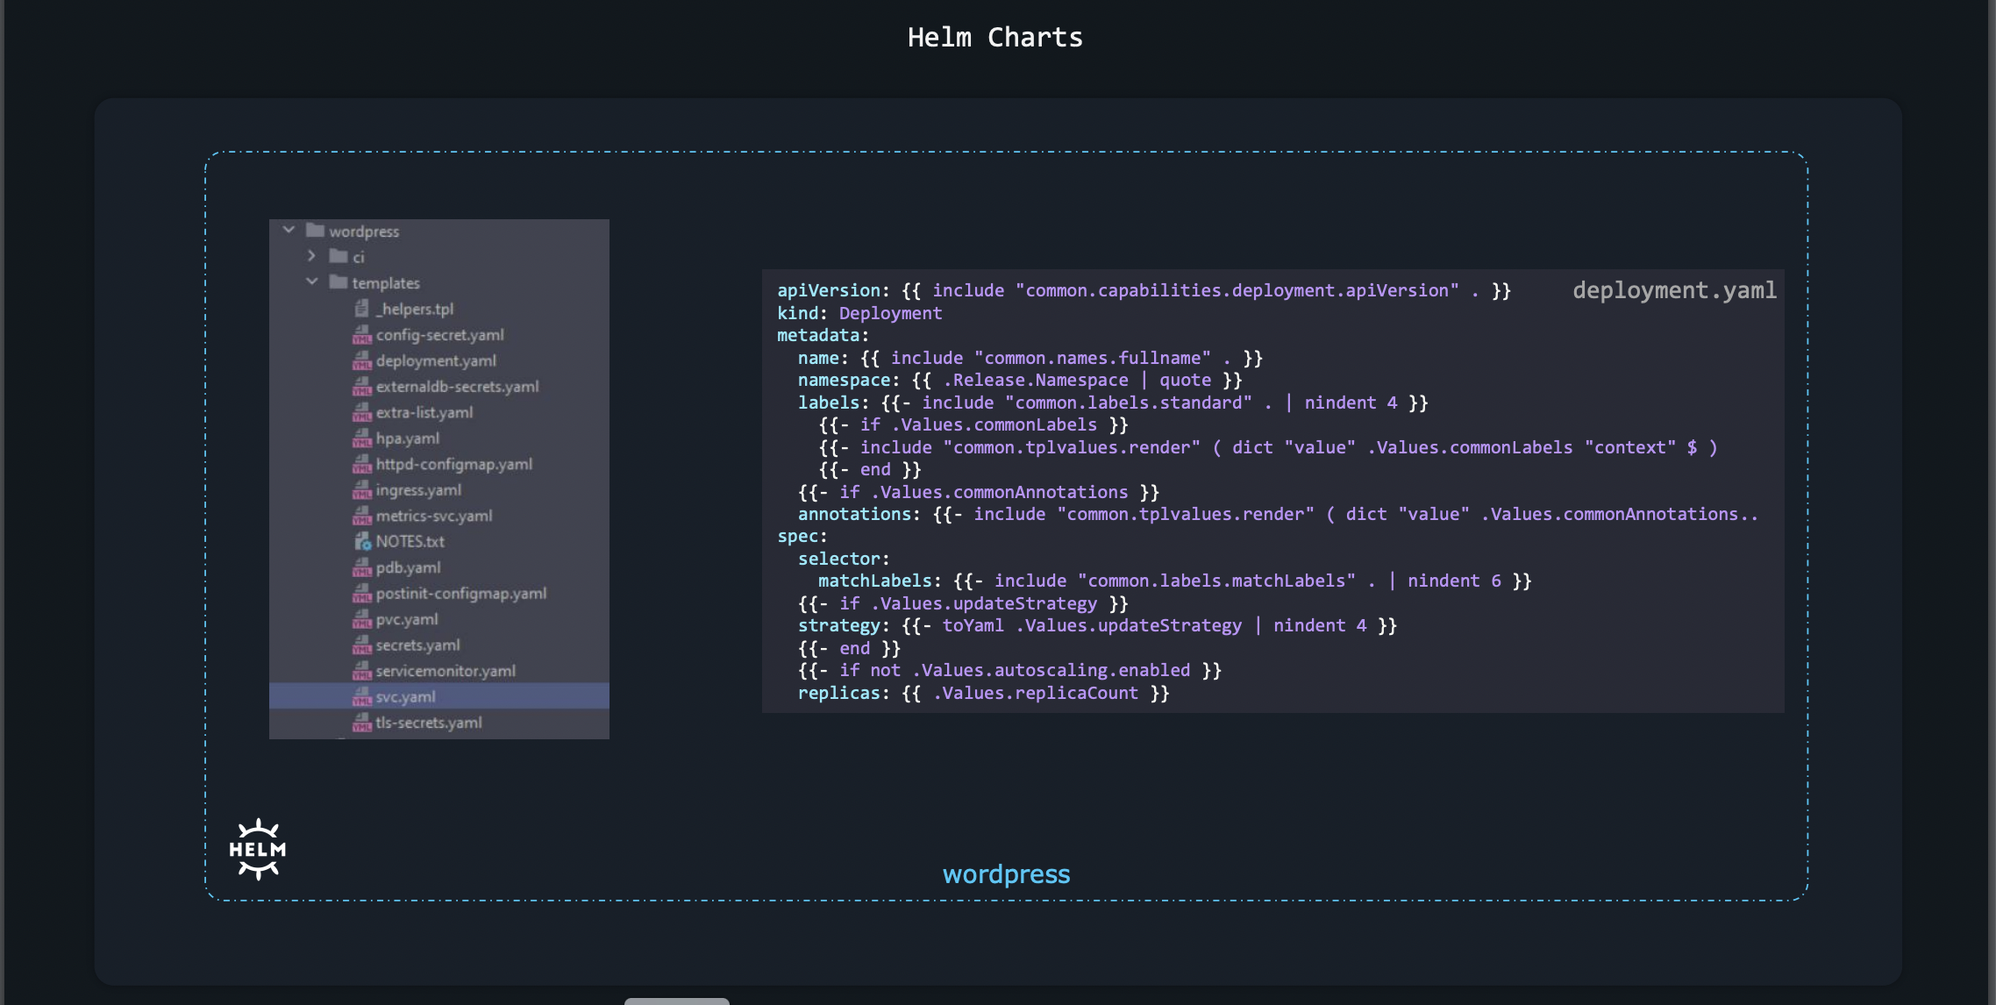

Slide 21
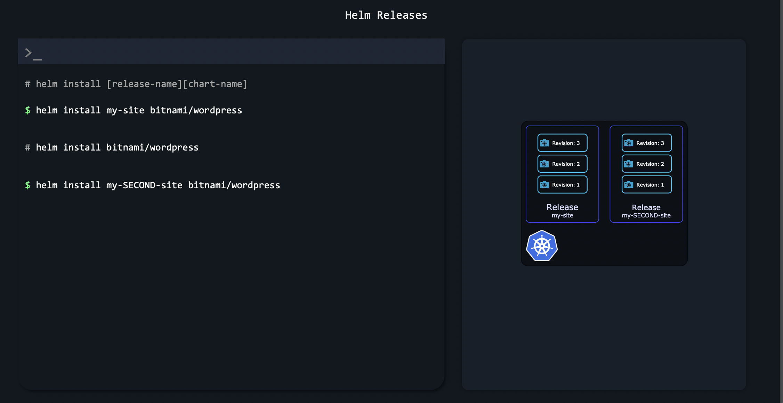

Slide 22
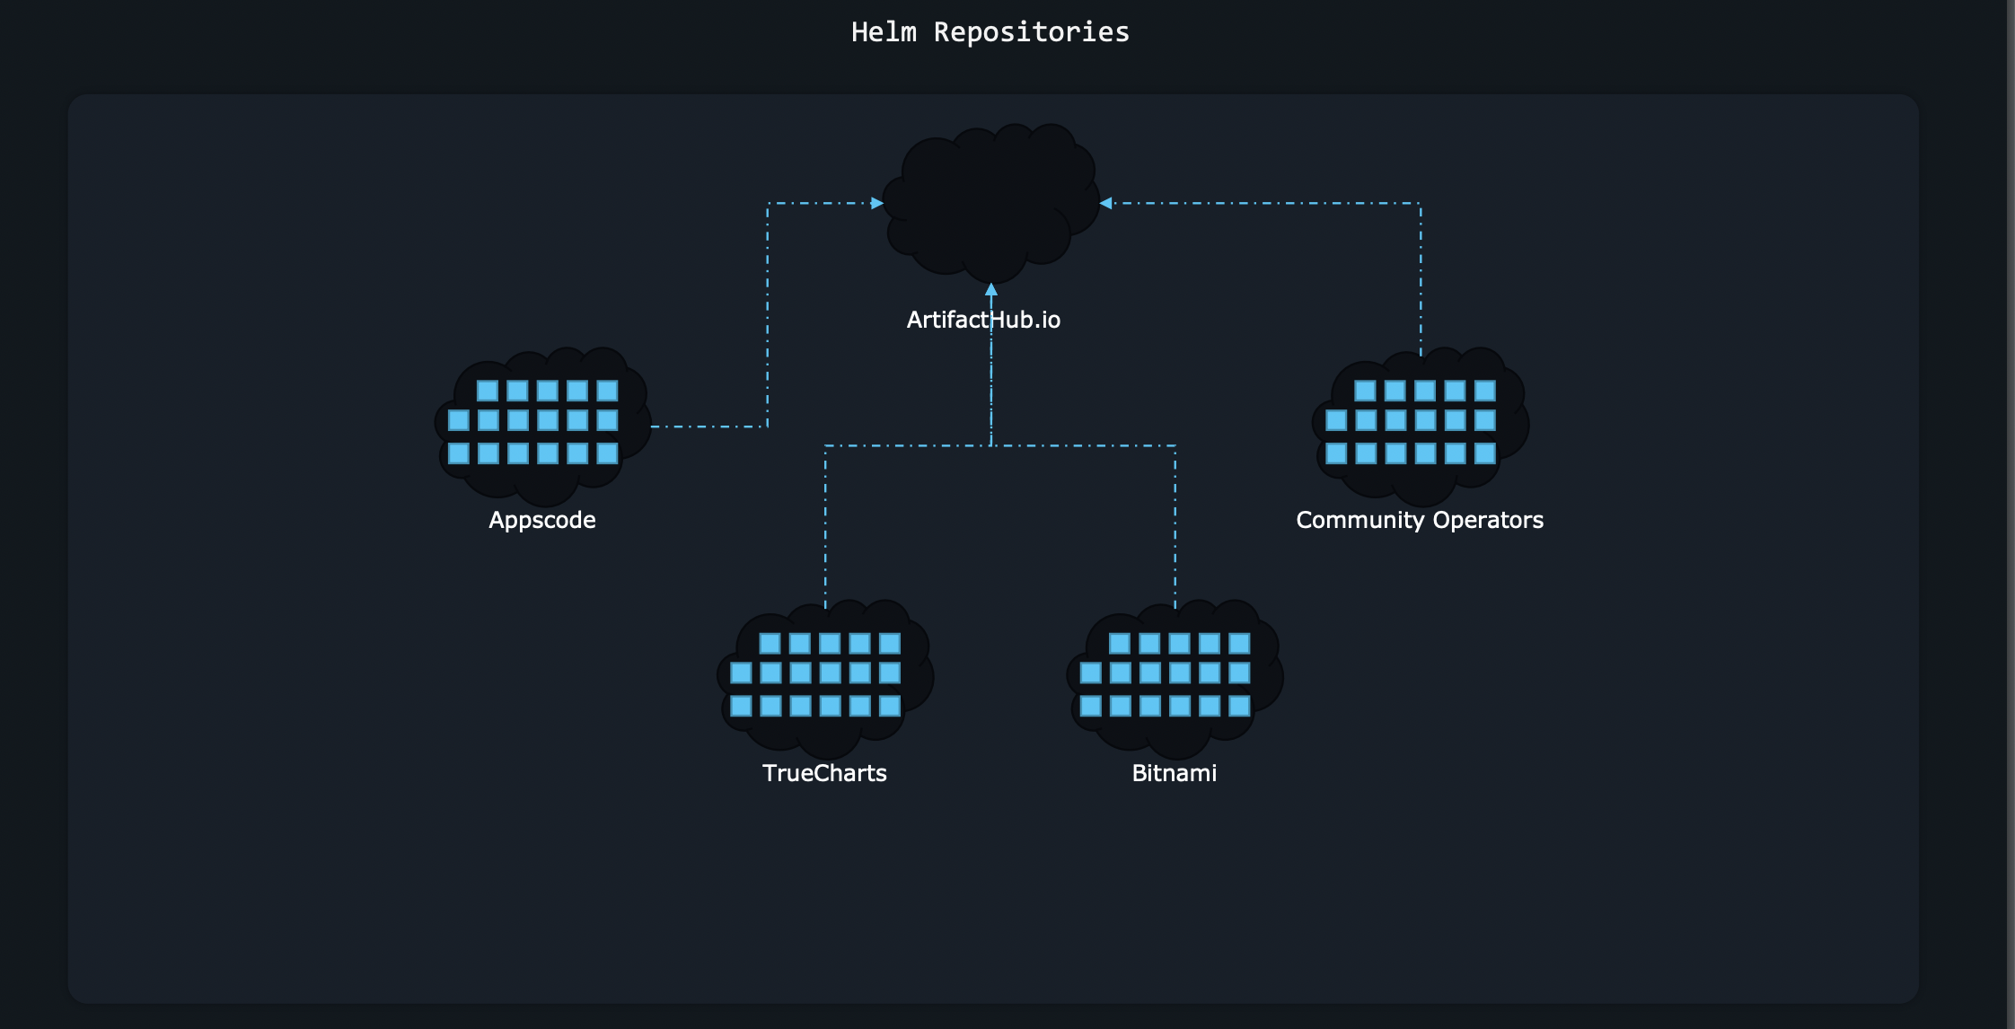

Slide 23
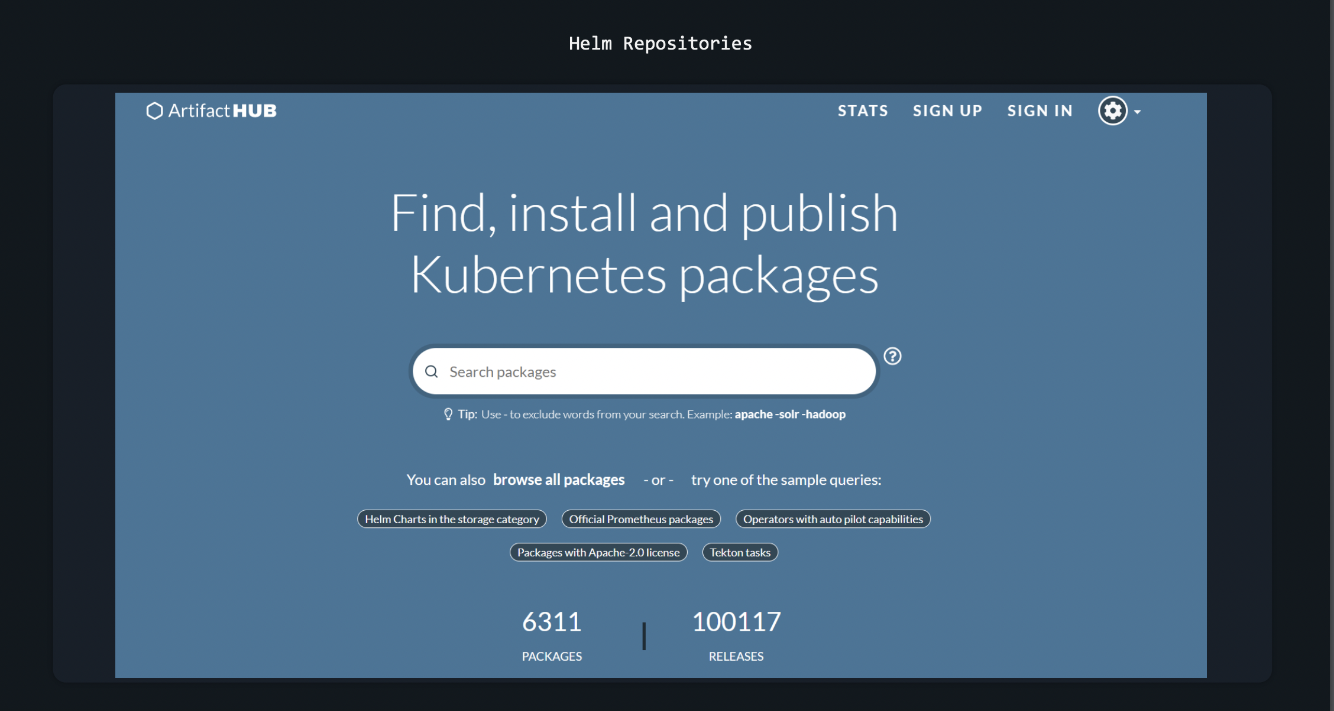

Slide 24
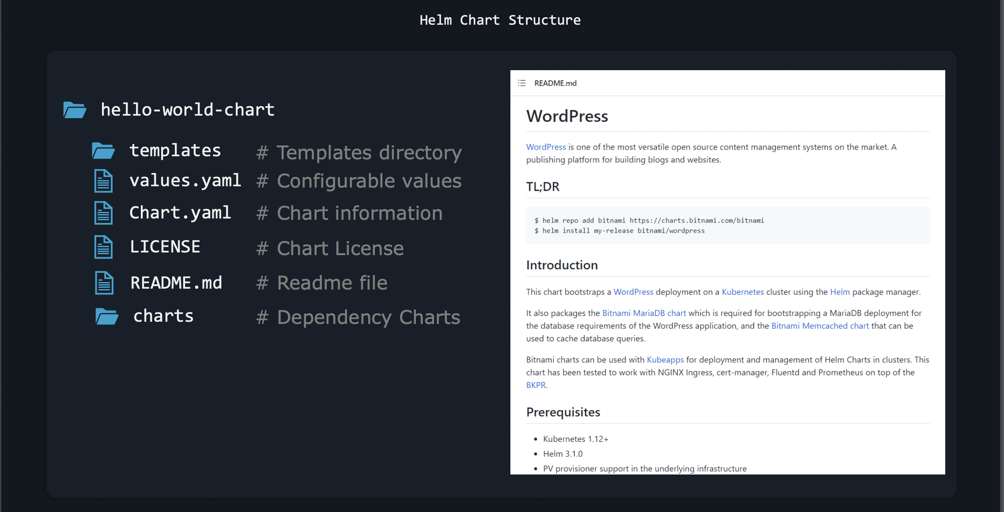

Slide 25
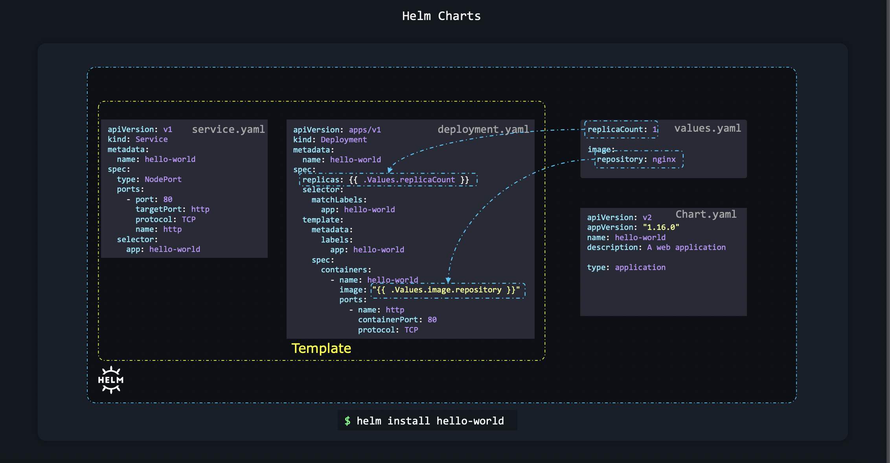

Slide 26
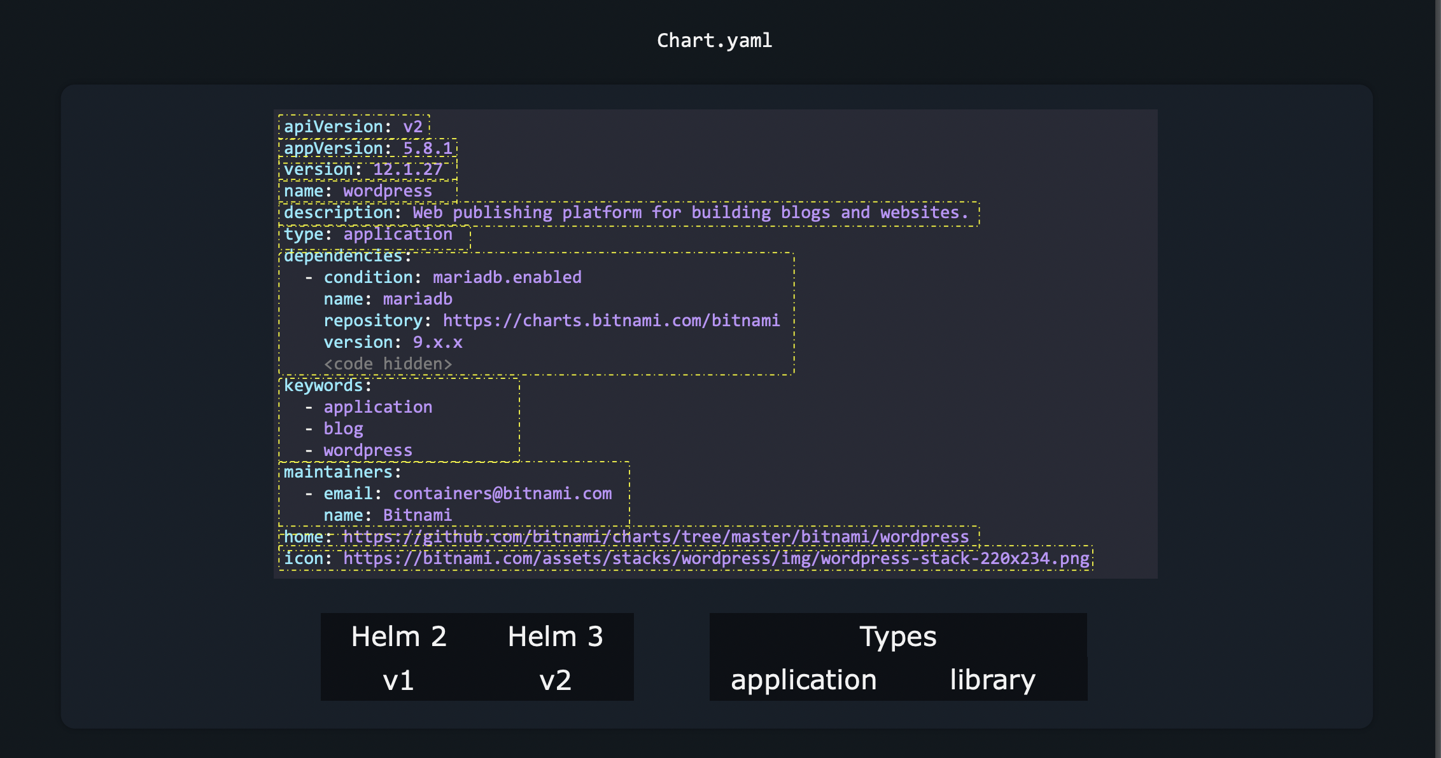

Slide 27
Working With HELM

Slide 28
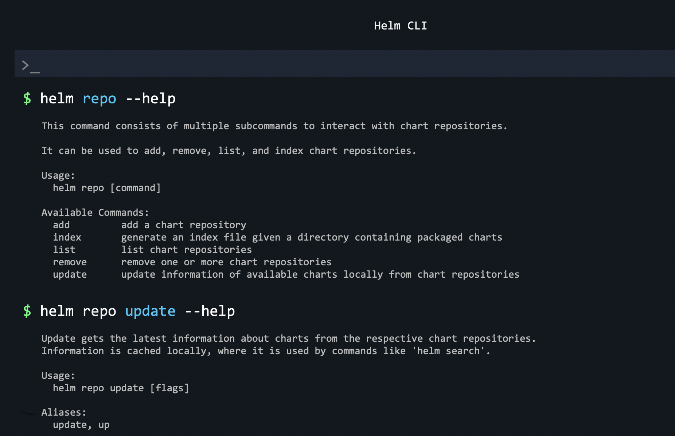

Slide 29
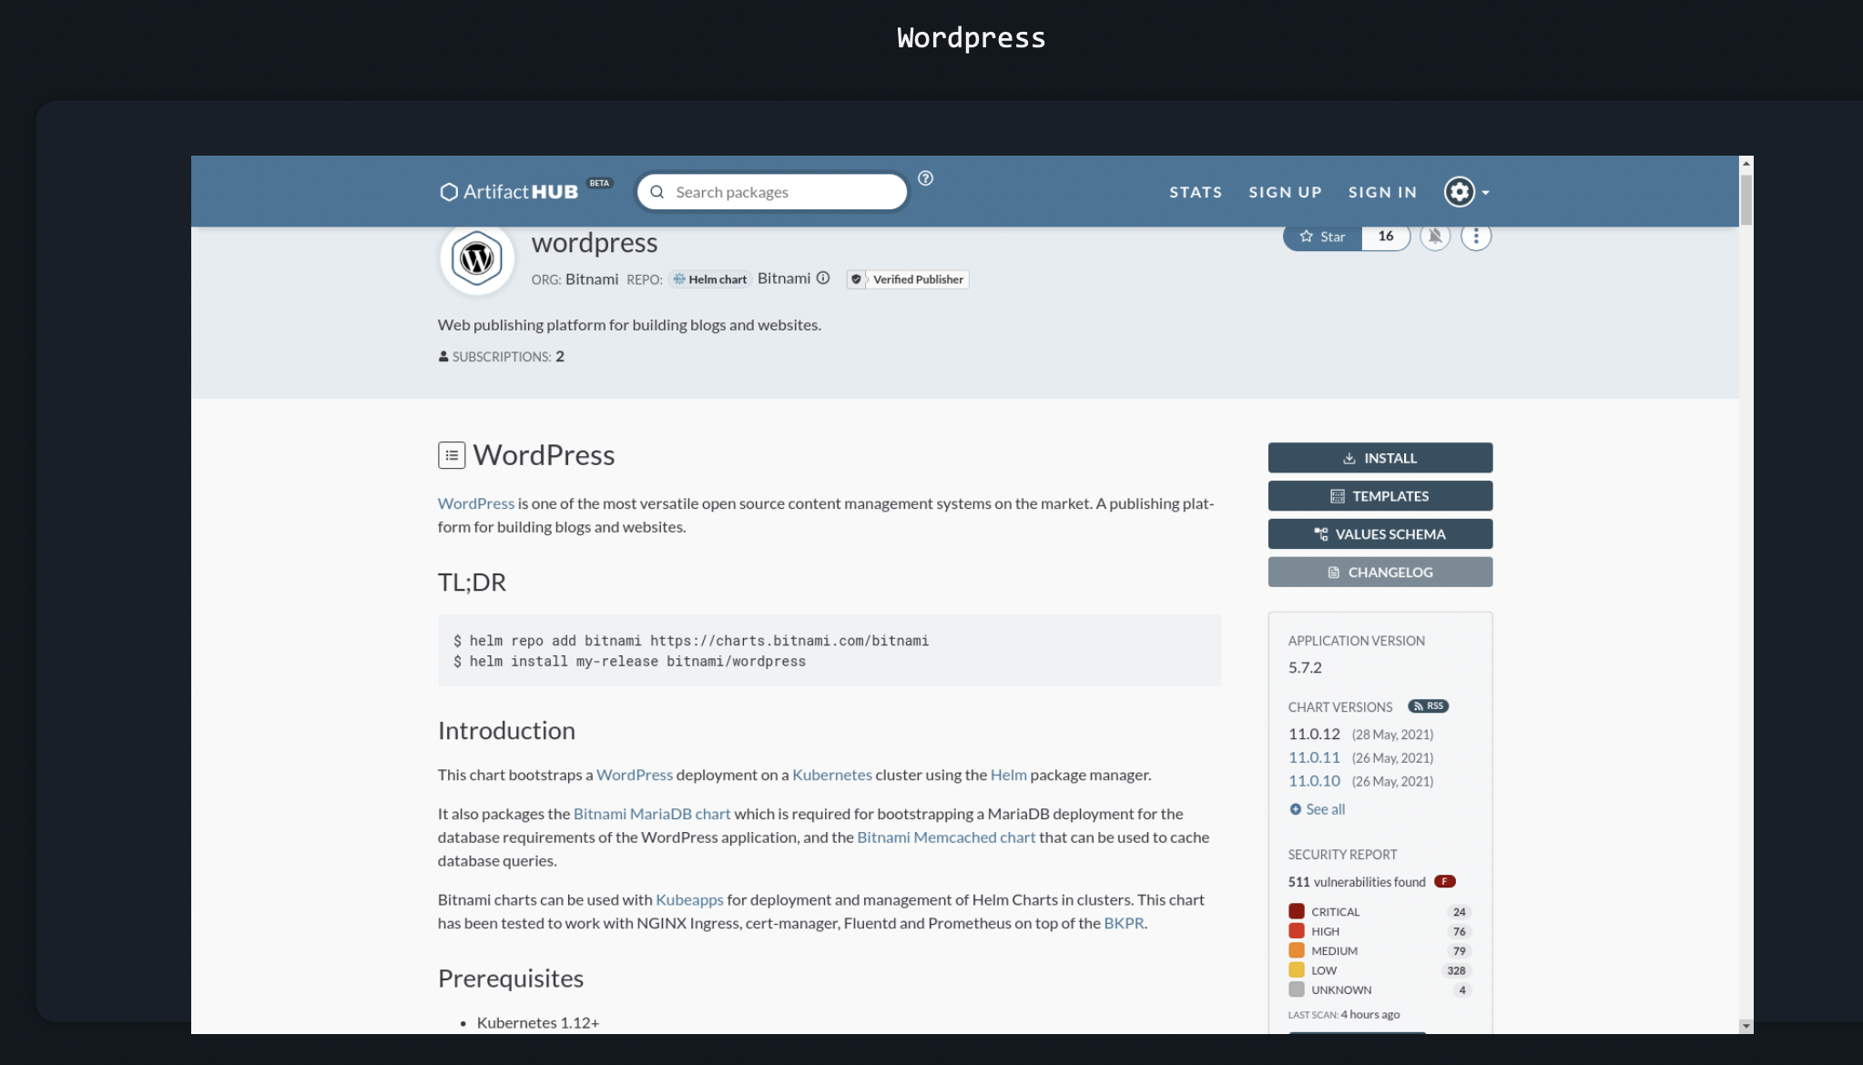
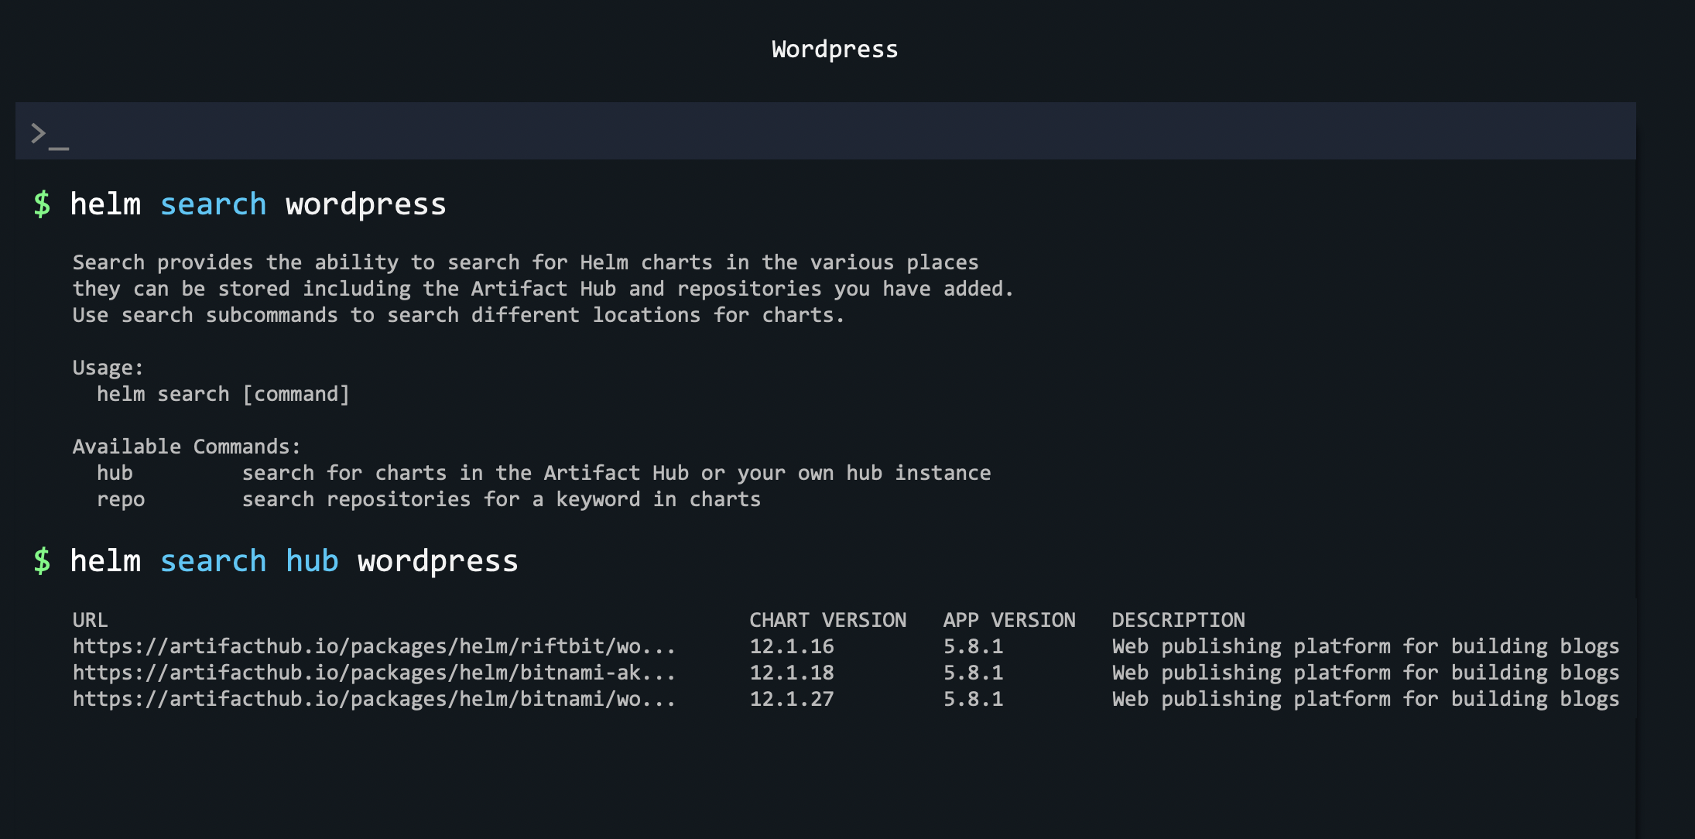

Slide 30
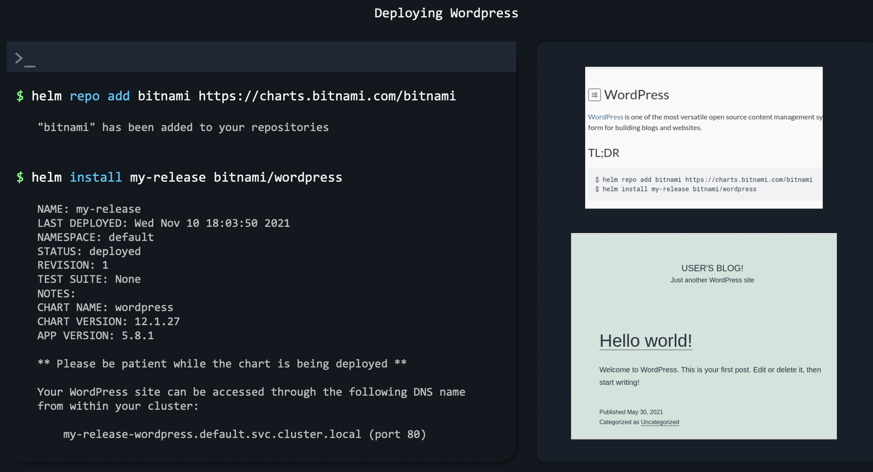

Slide 31
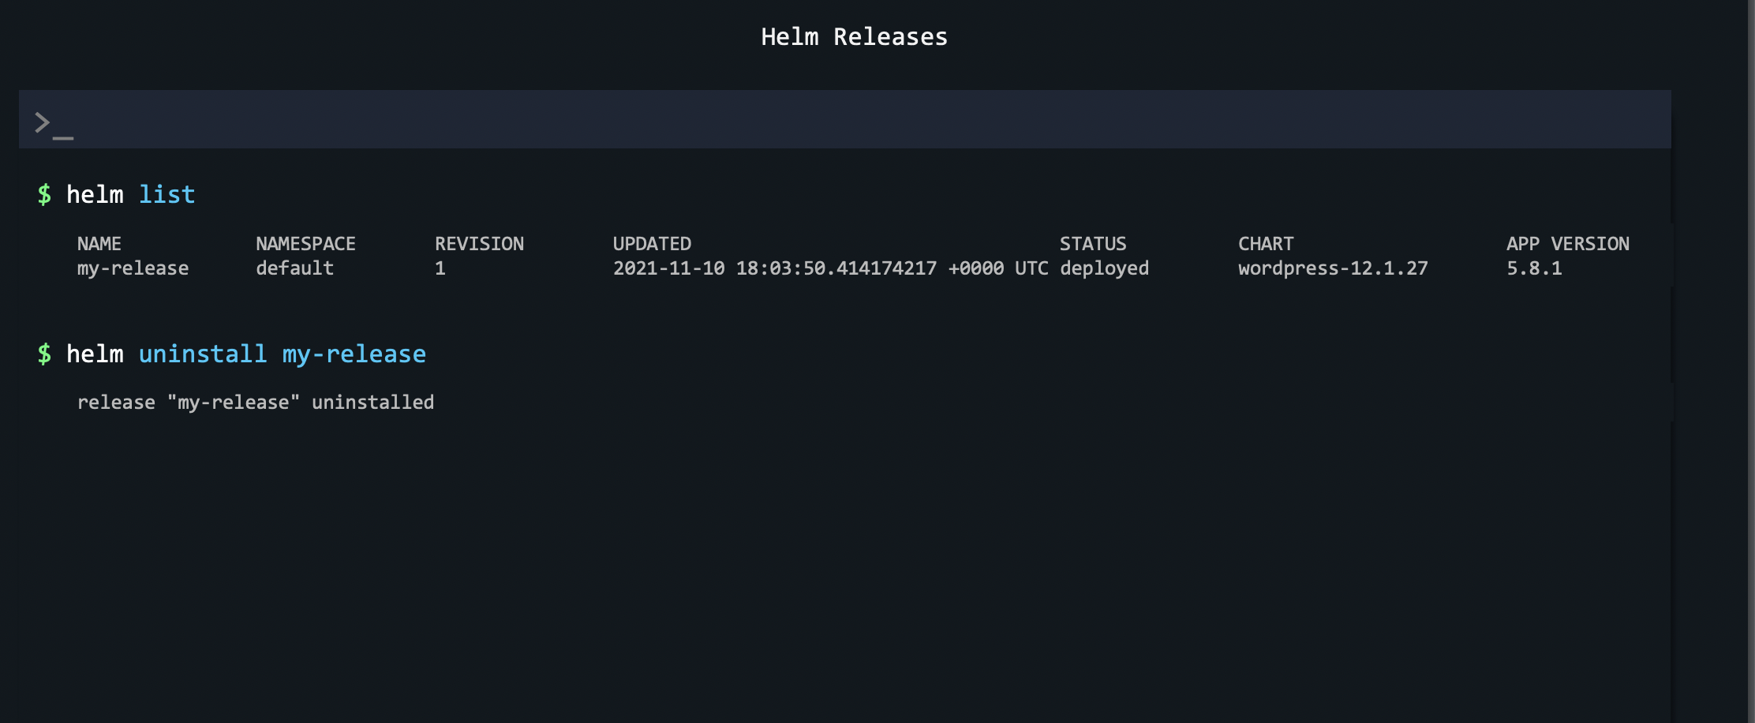
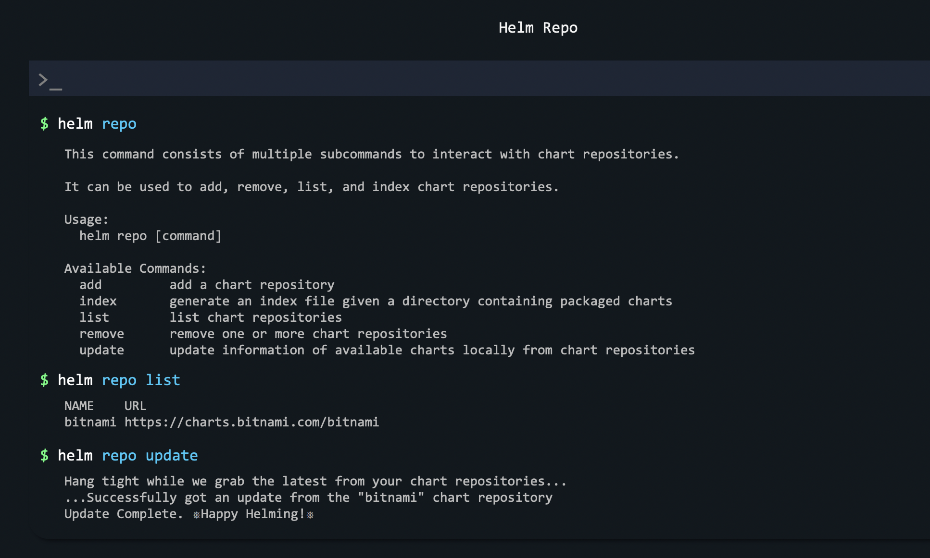

Slide 32
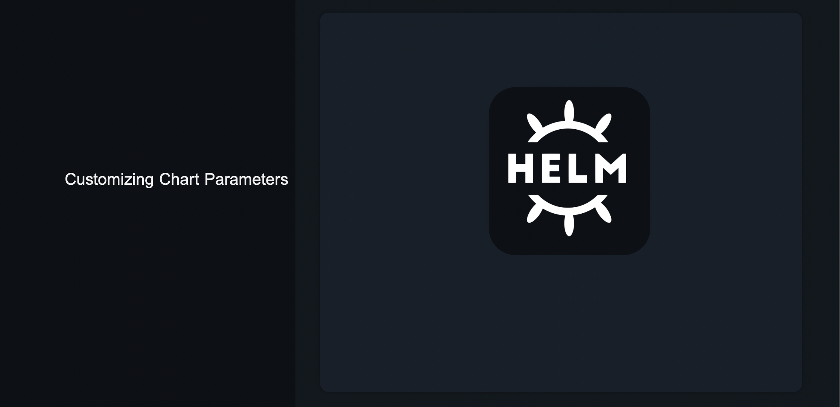

Slide 33
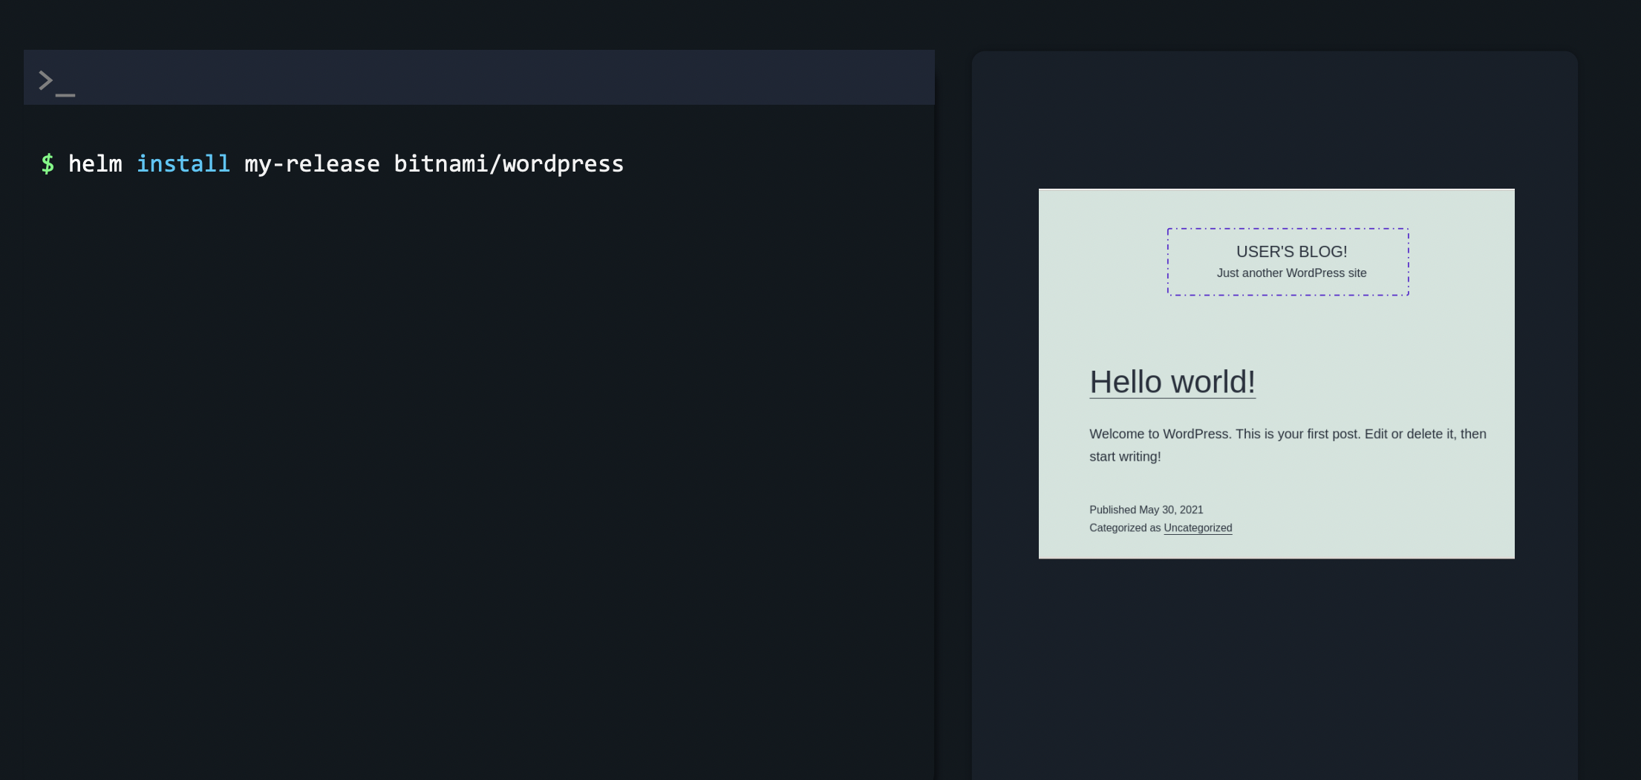

Slide 34
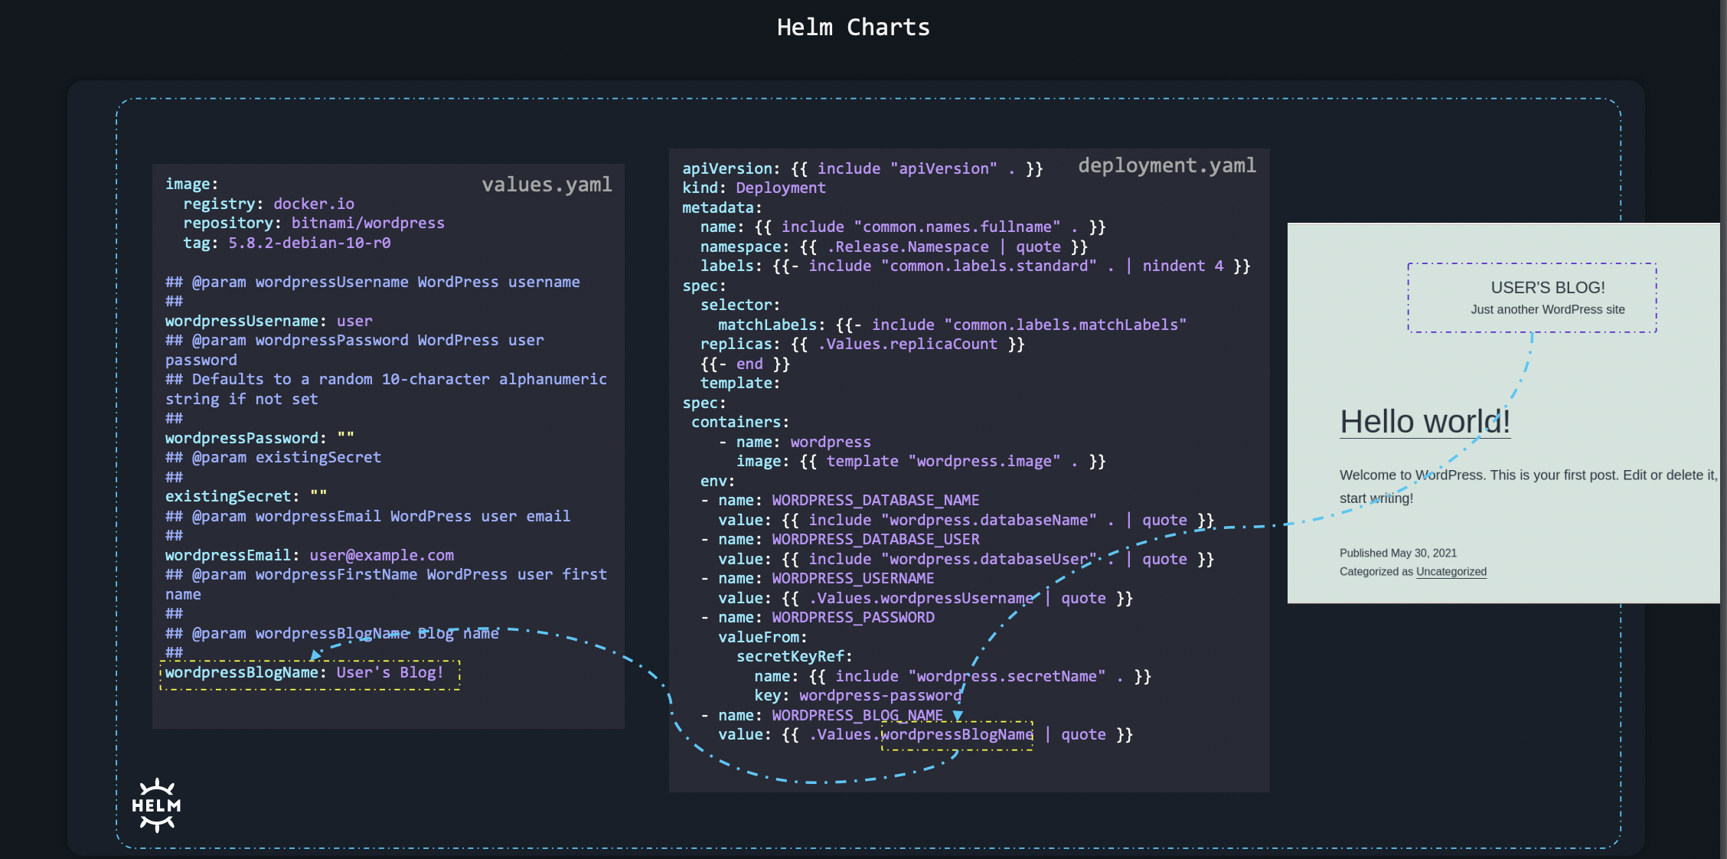

Slide 35
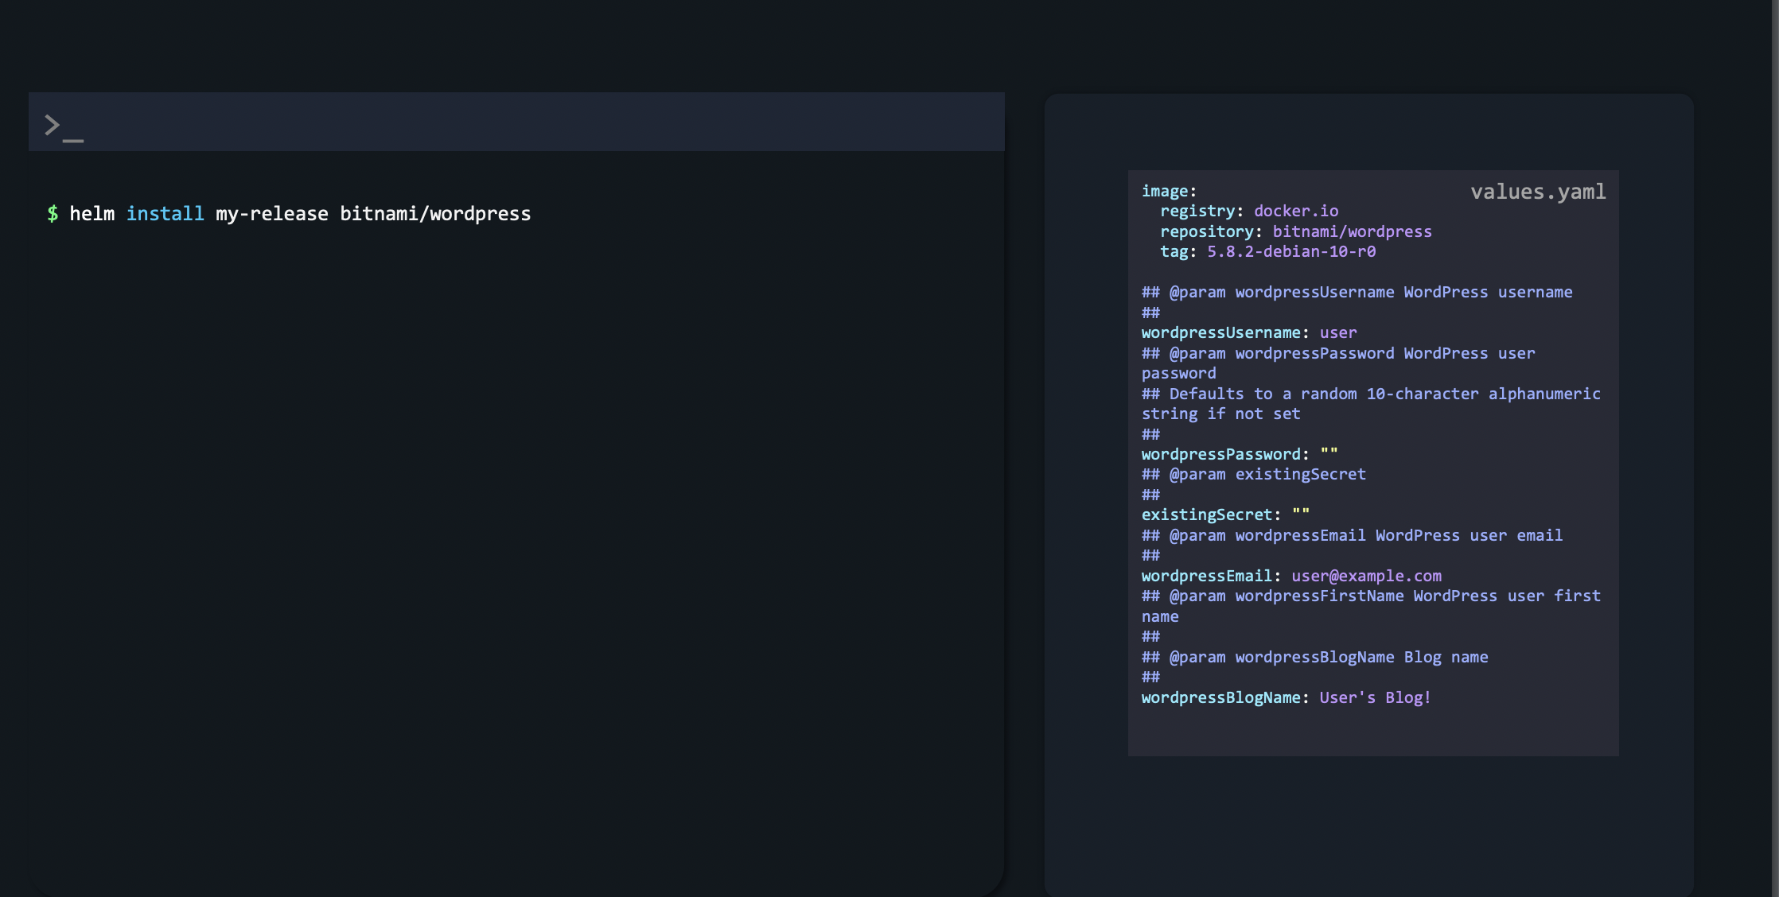

Slide 36
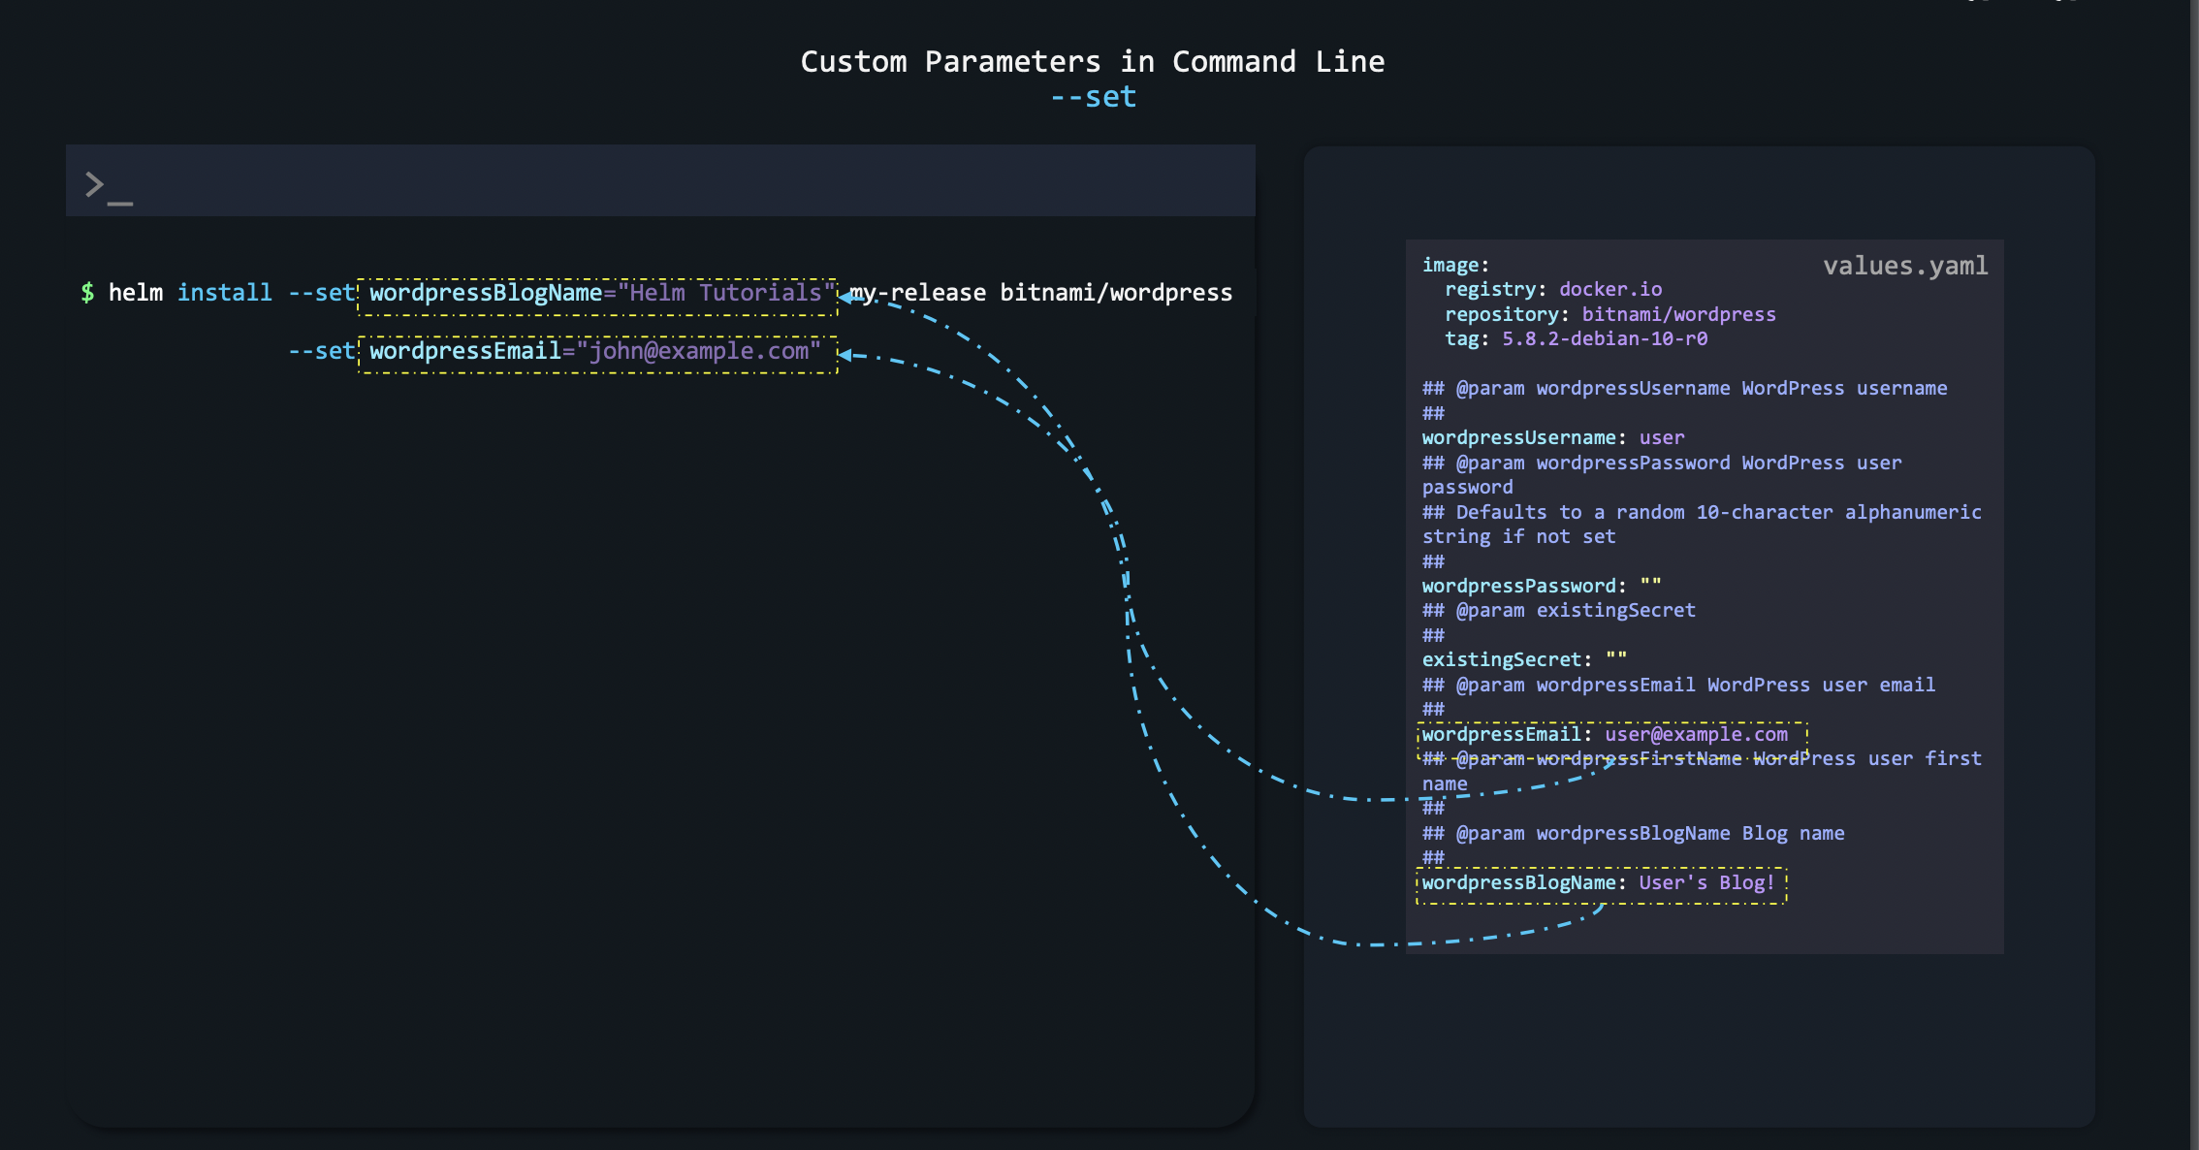

Slide 37
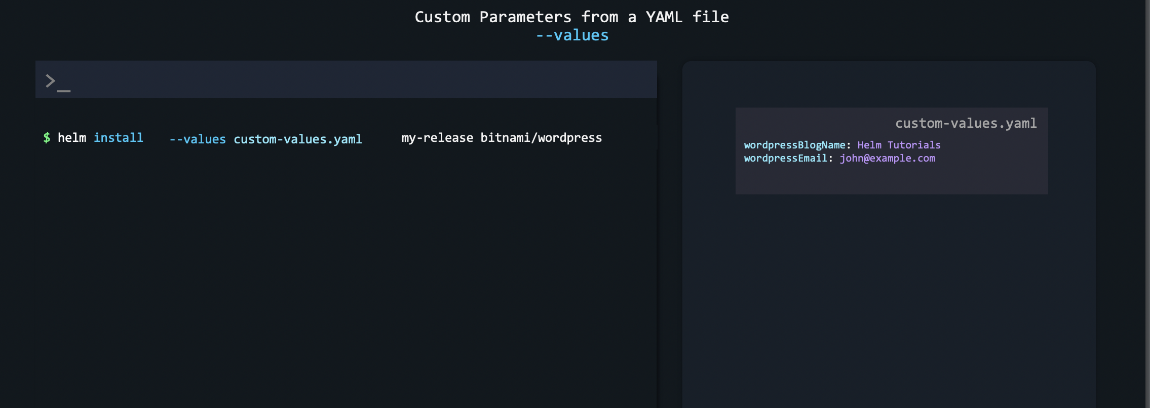

Slide 38
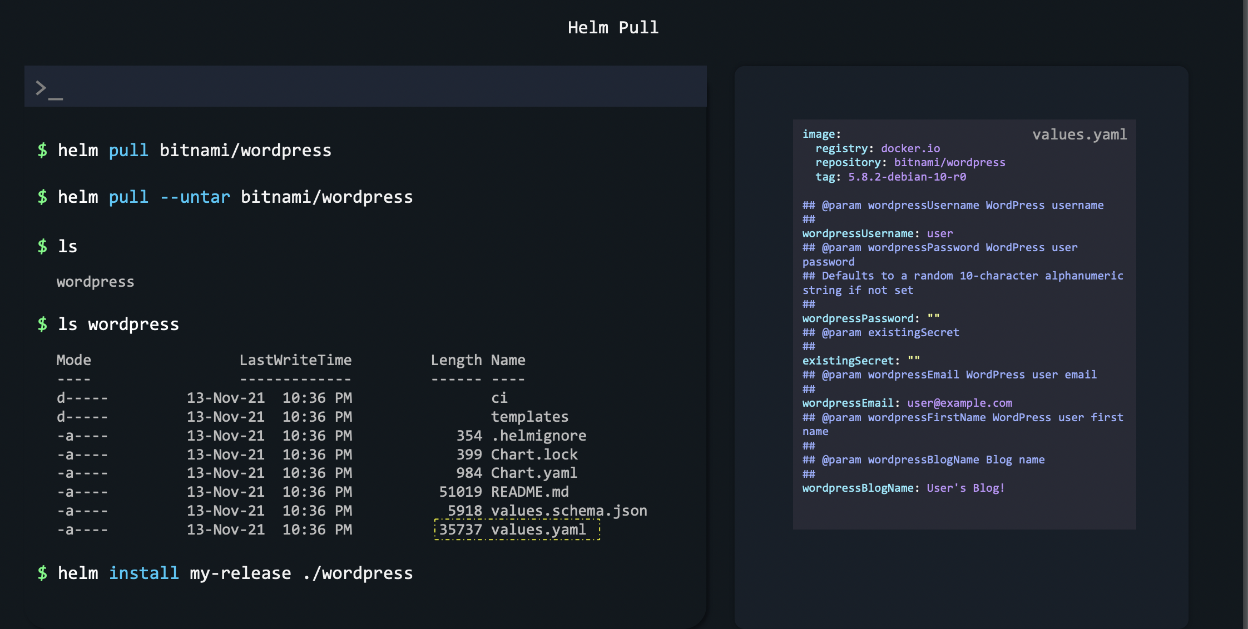

Slide 39


Slide 40
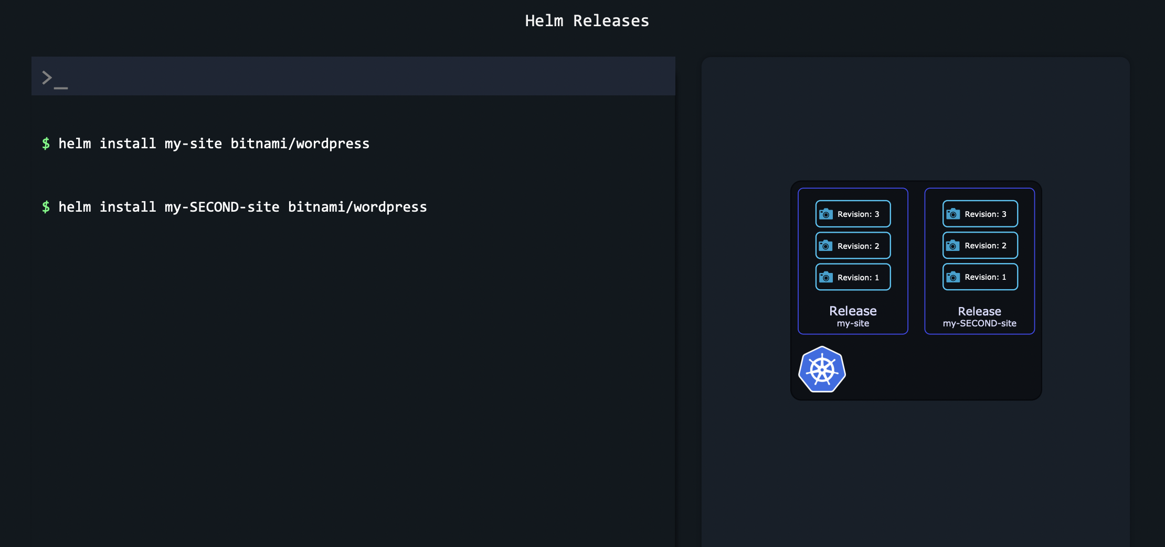

Slide 41
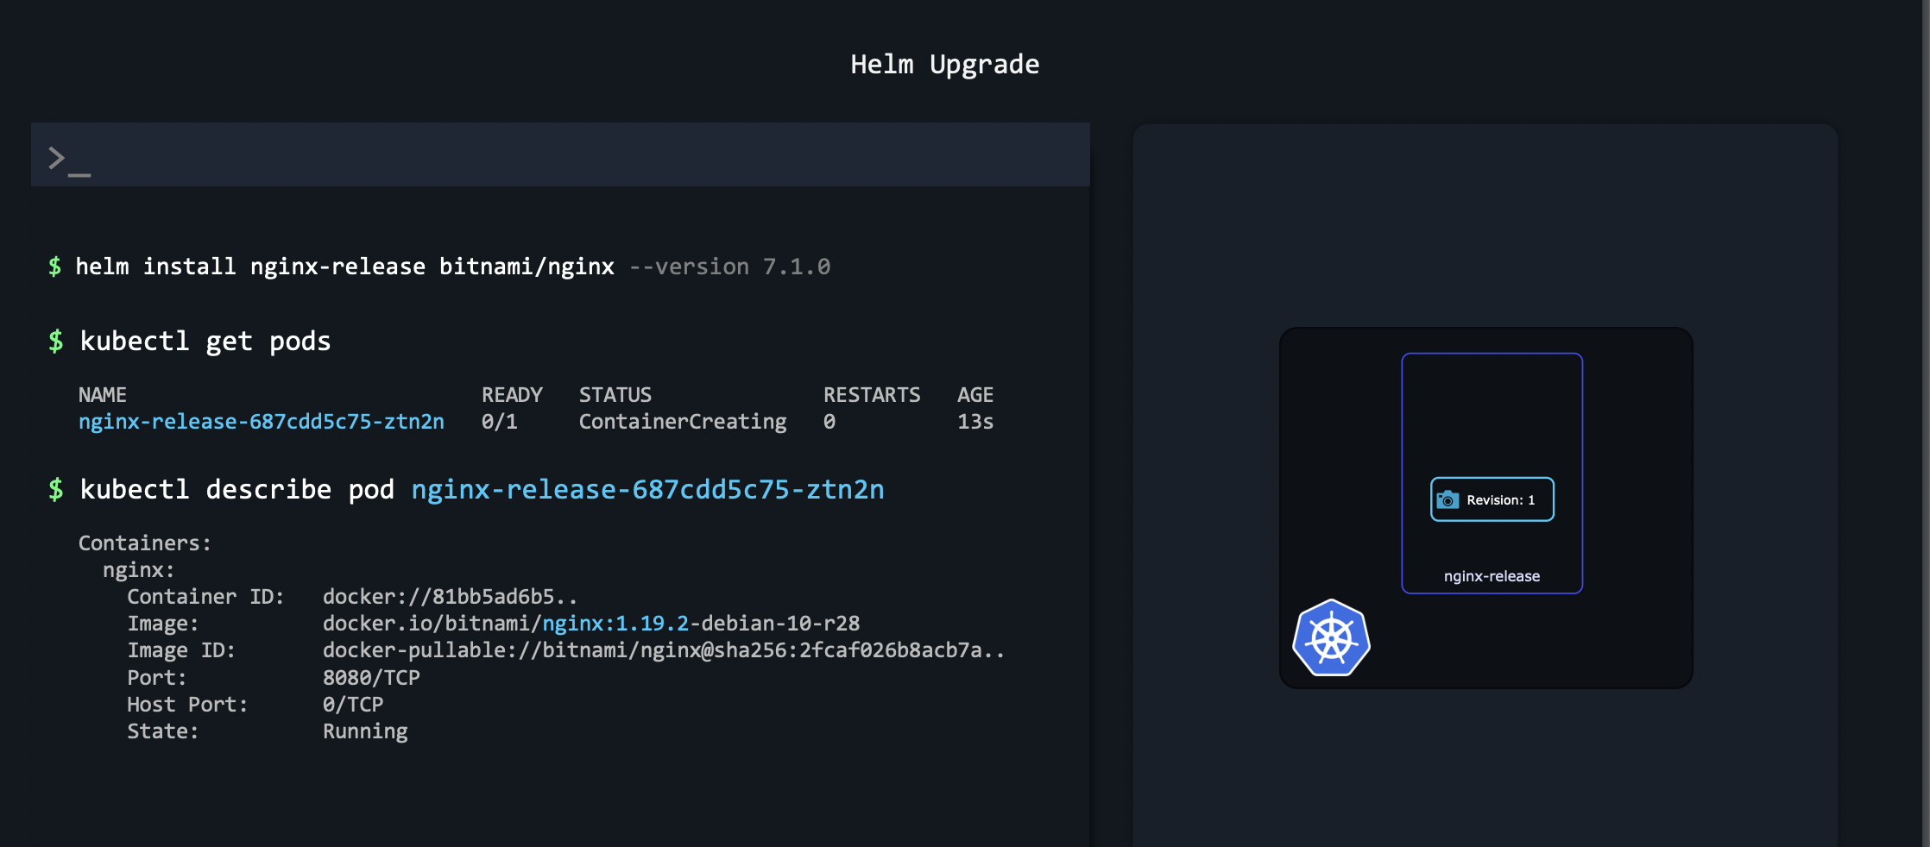

Slide 42
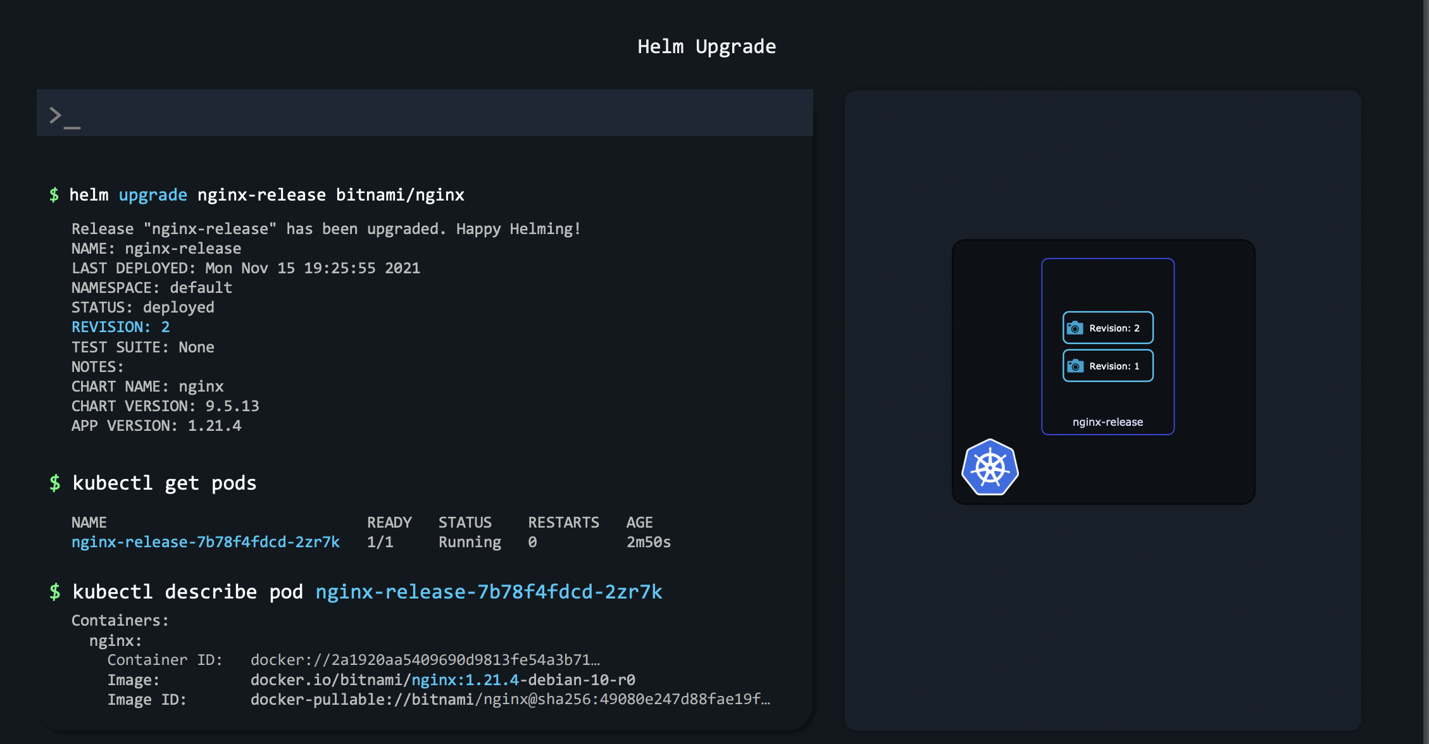

Slide 43
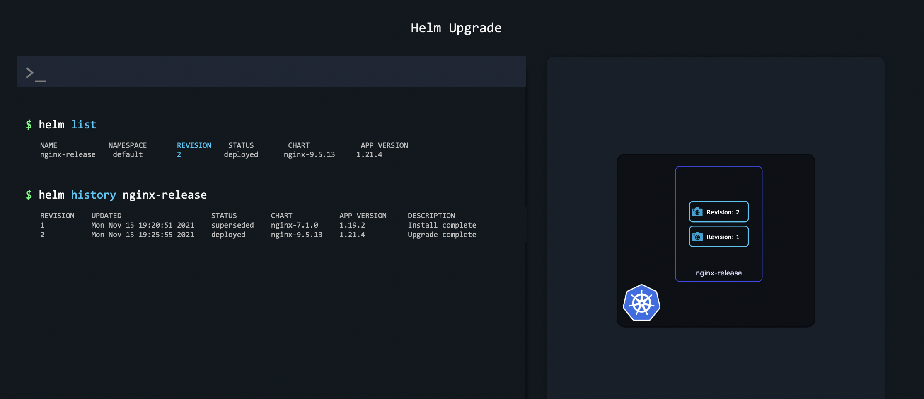

Slide 44
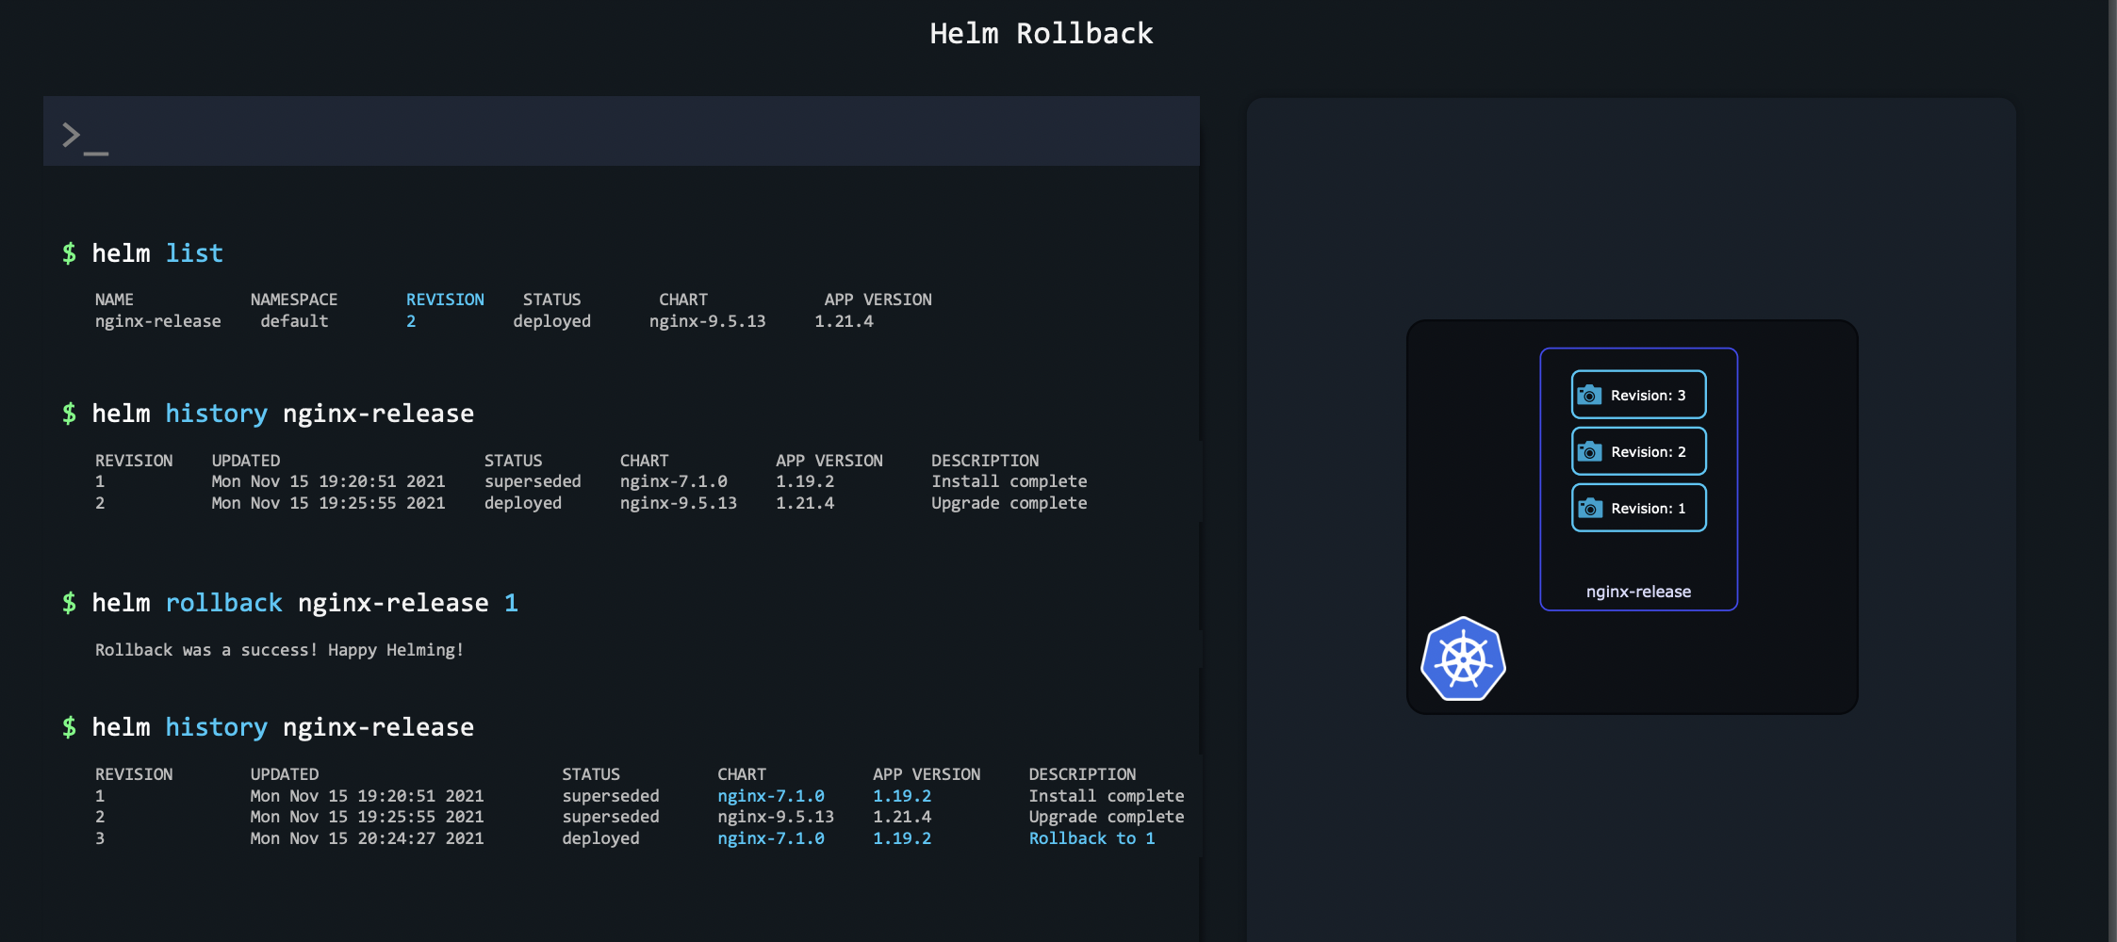

Slide 46
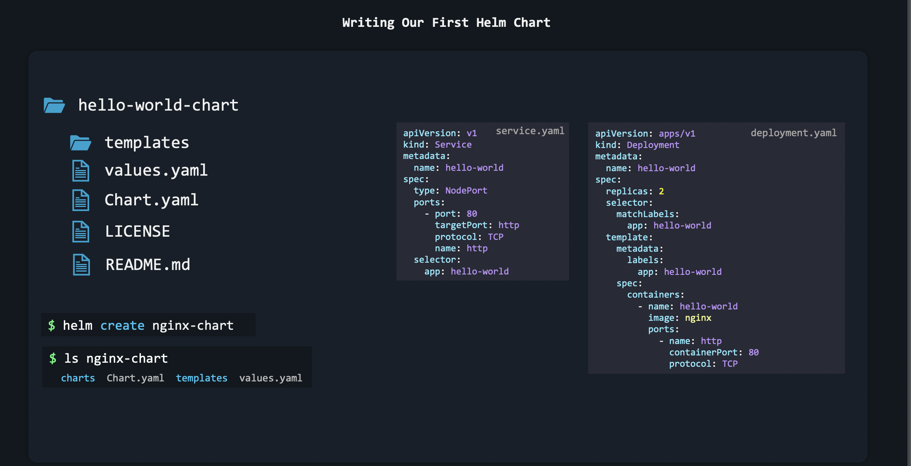

Slide 47
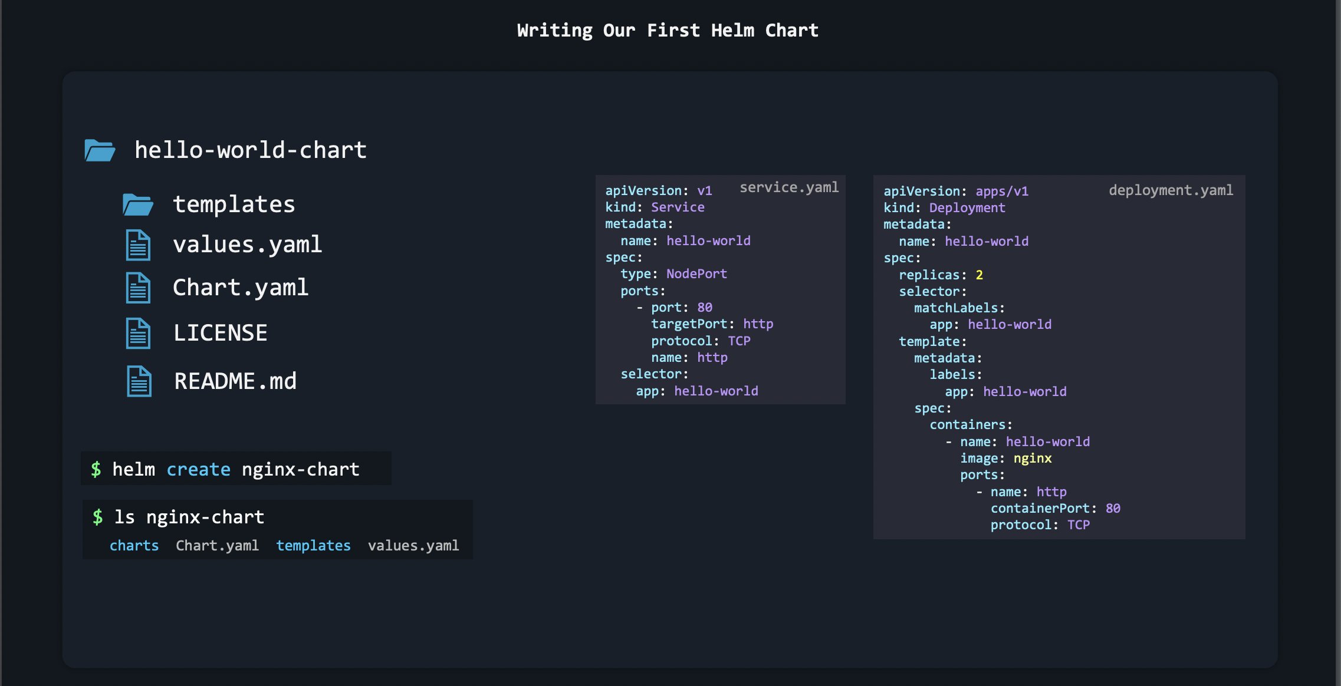

Slide 48
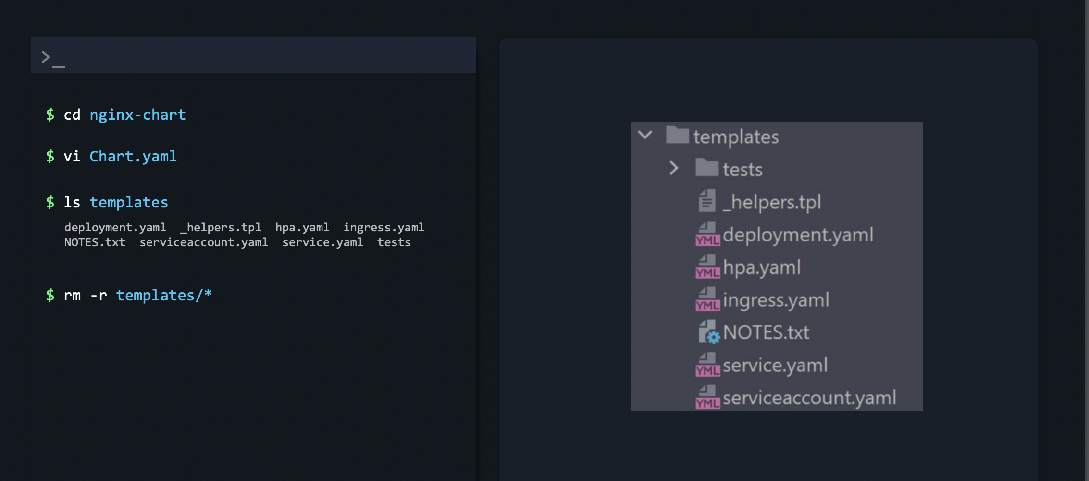

Slide 49
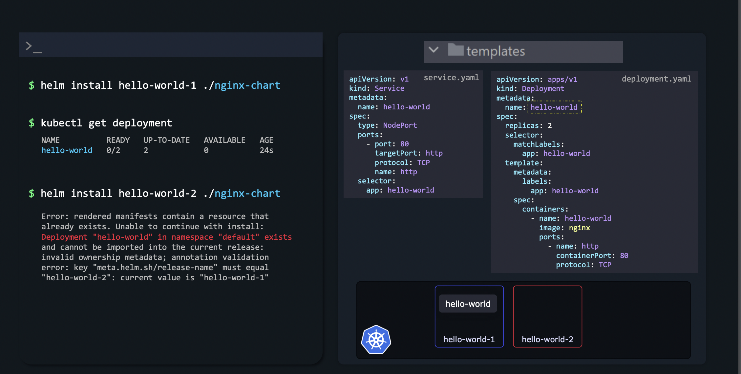

Slide 50
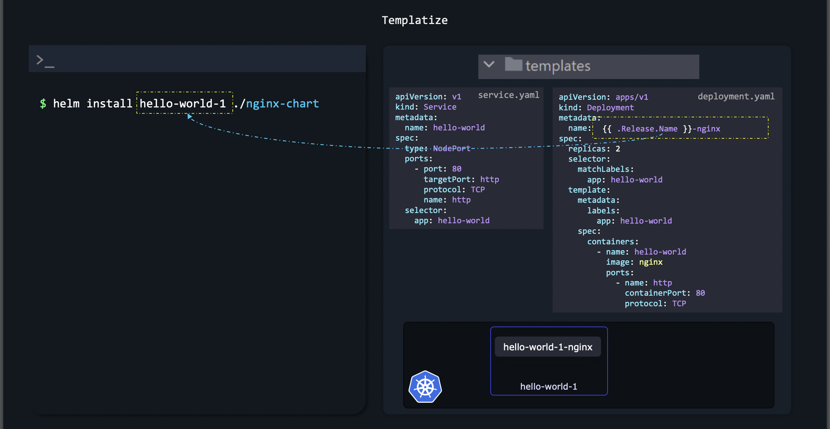

Slide 51
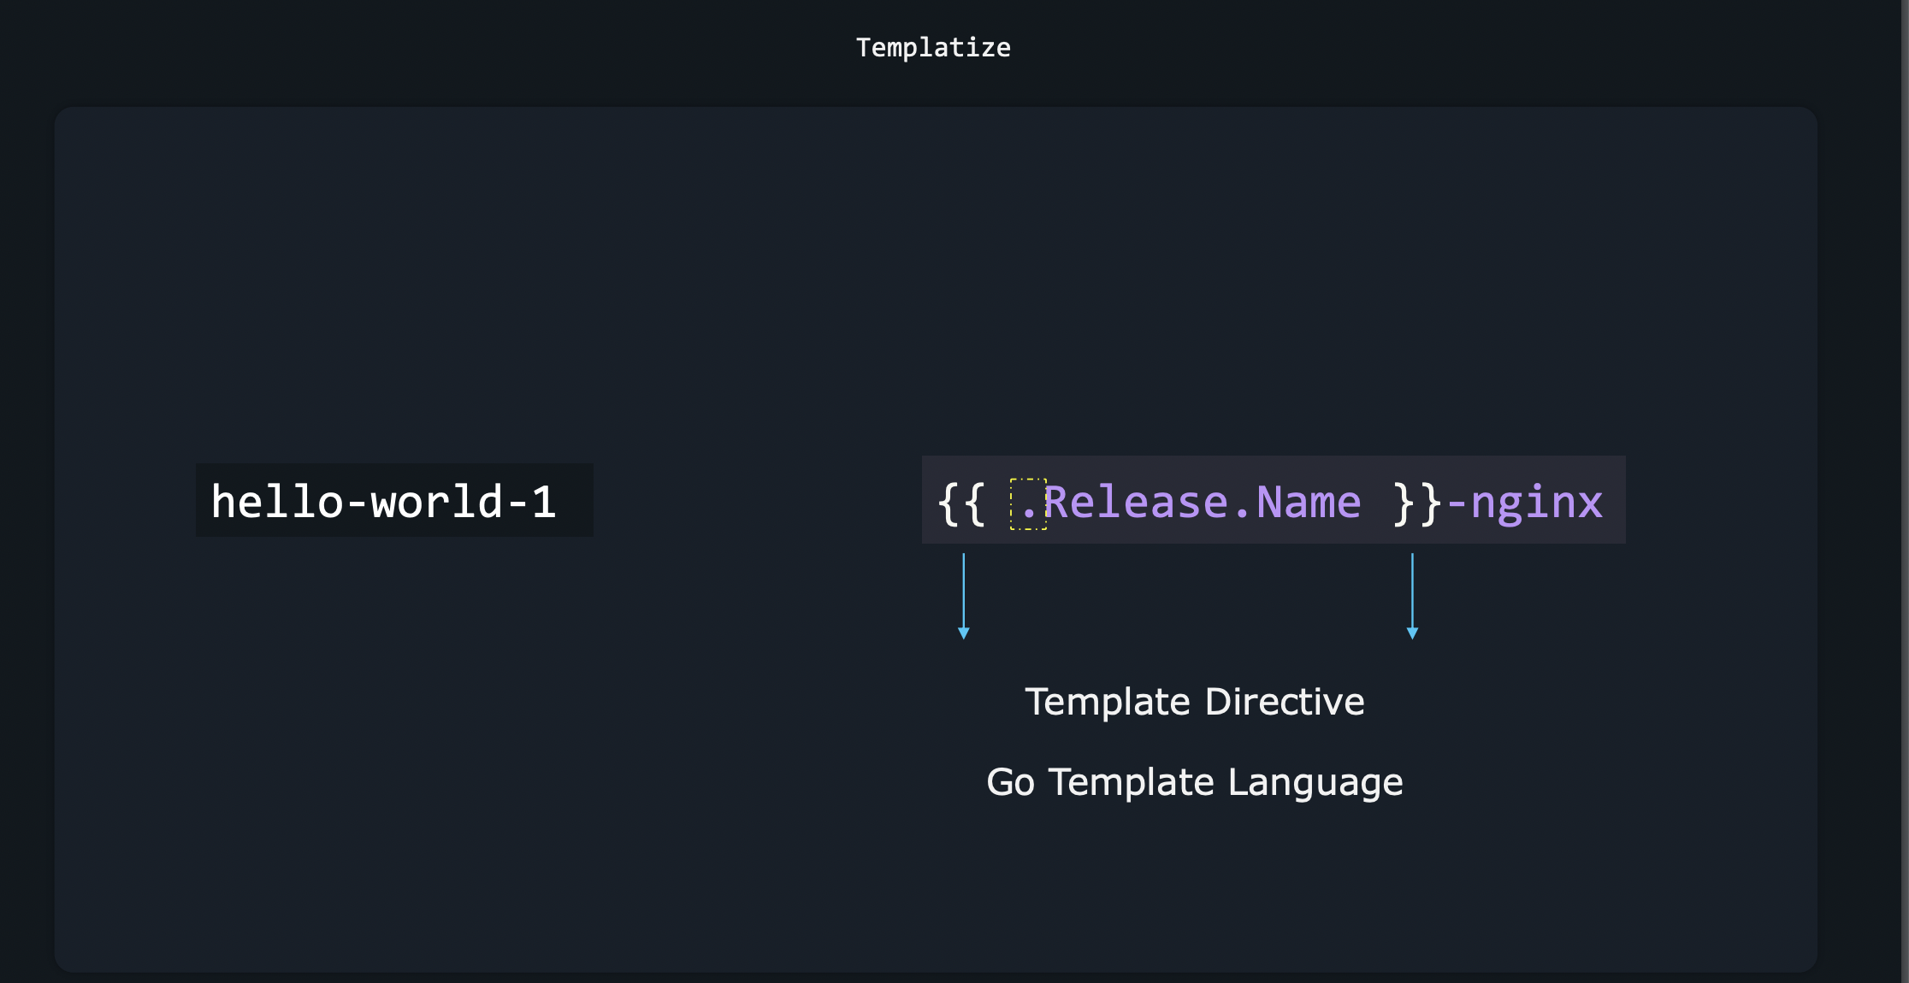

Slide 52
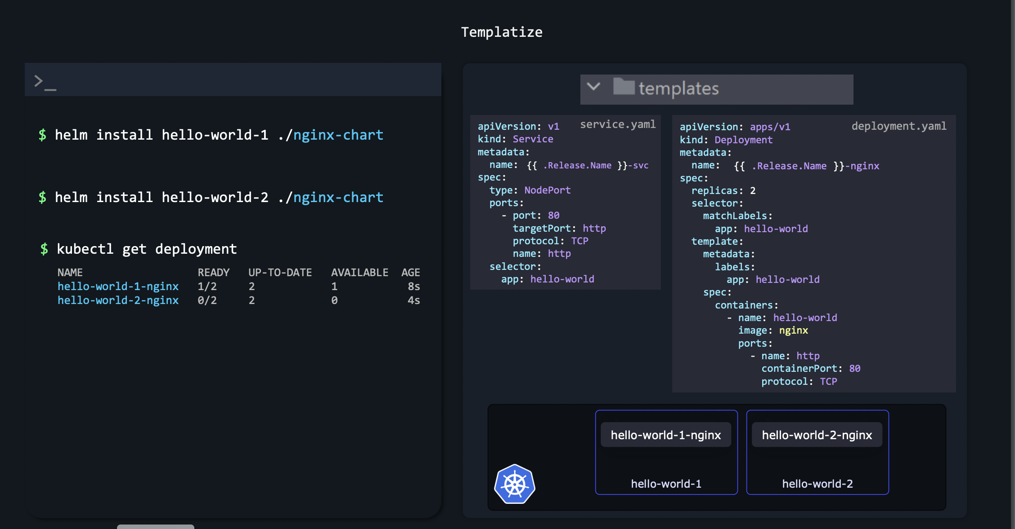

Slide 53
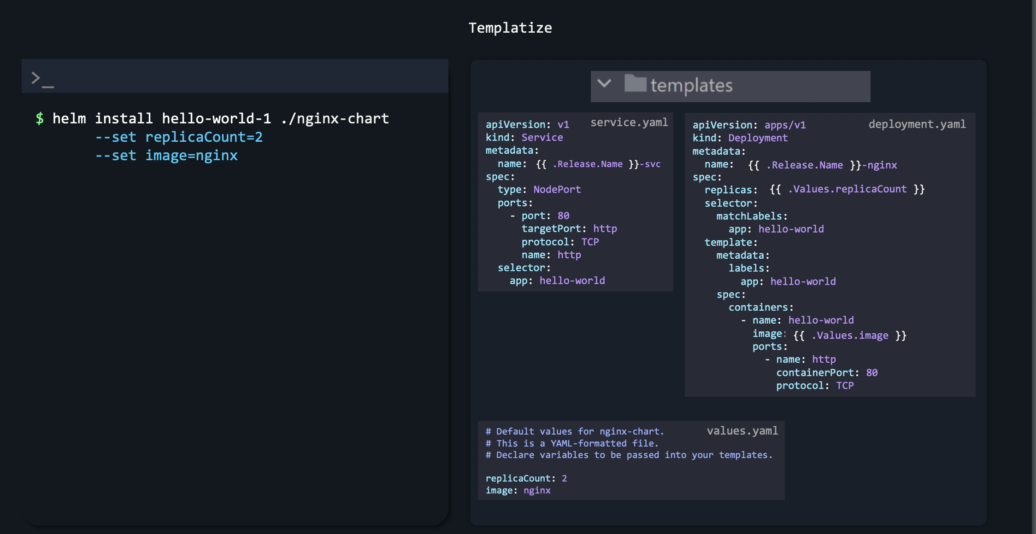

Slide 54
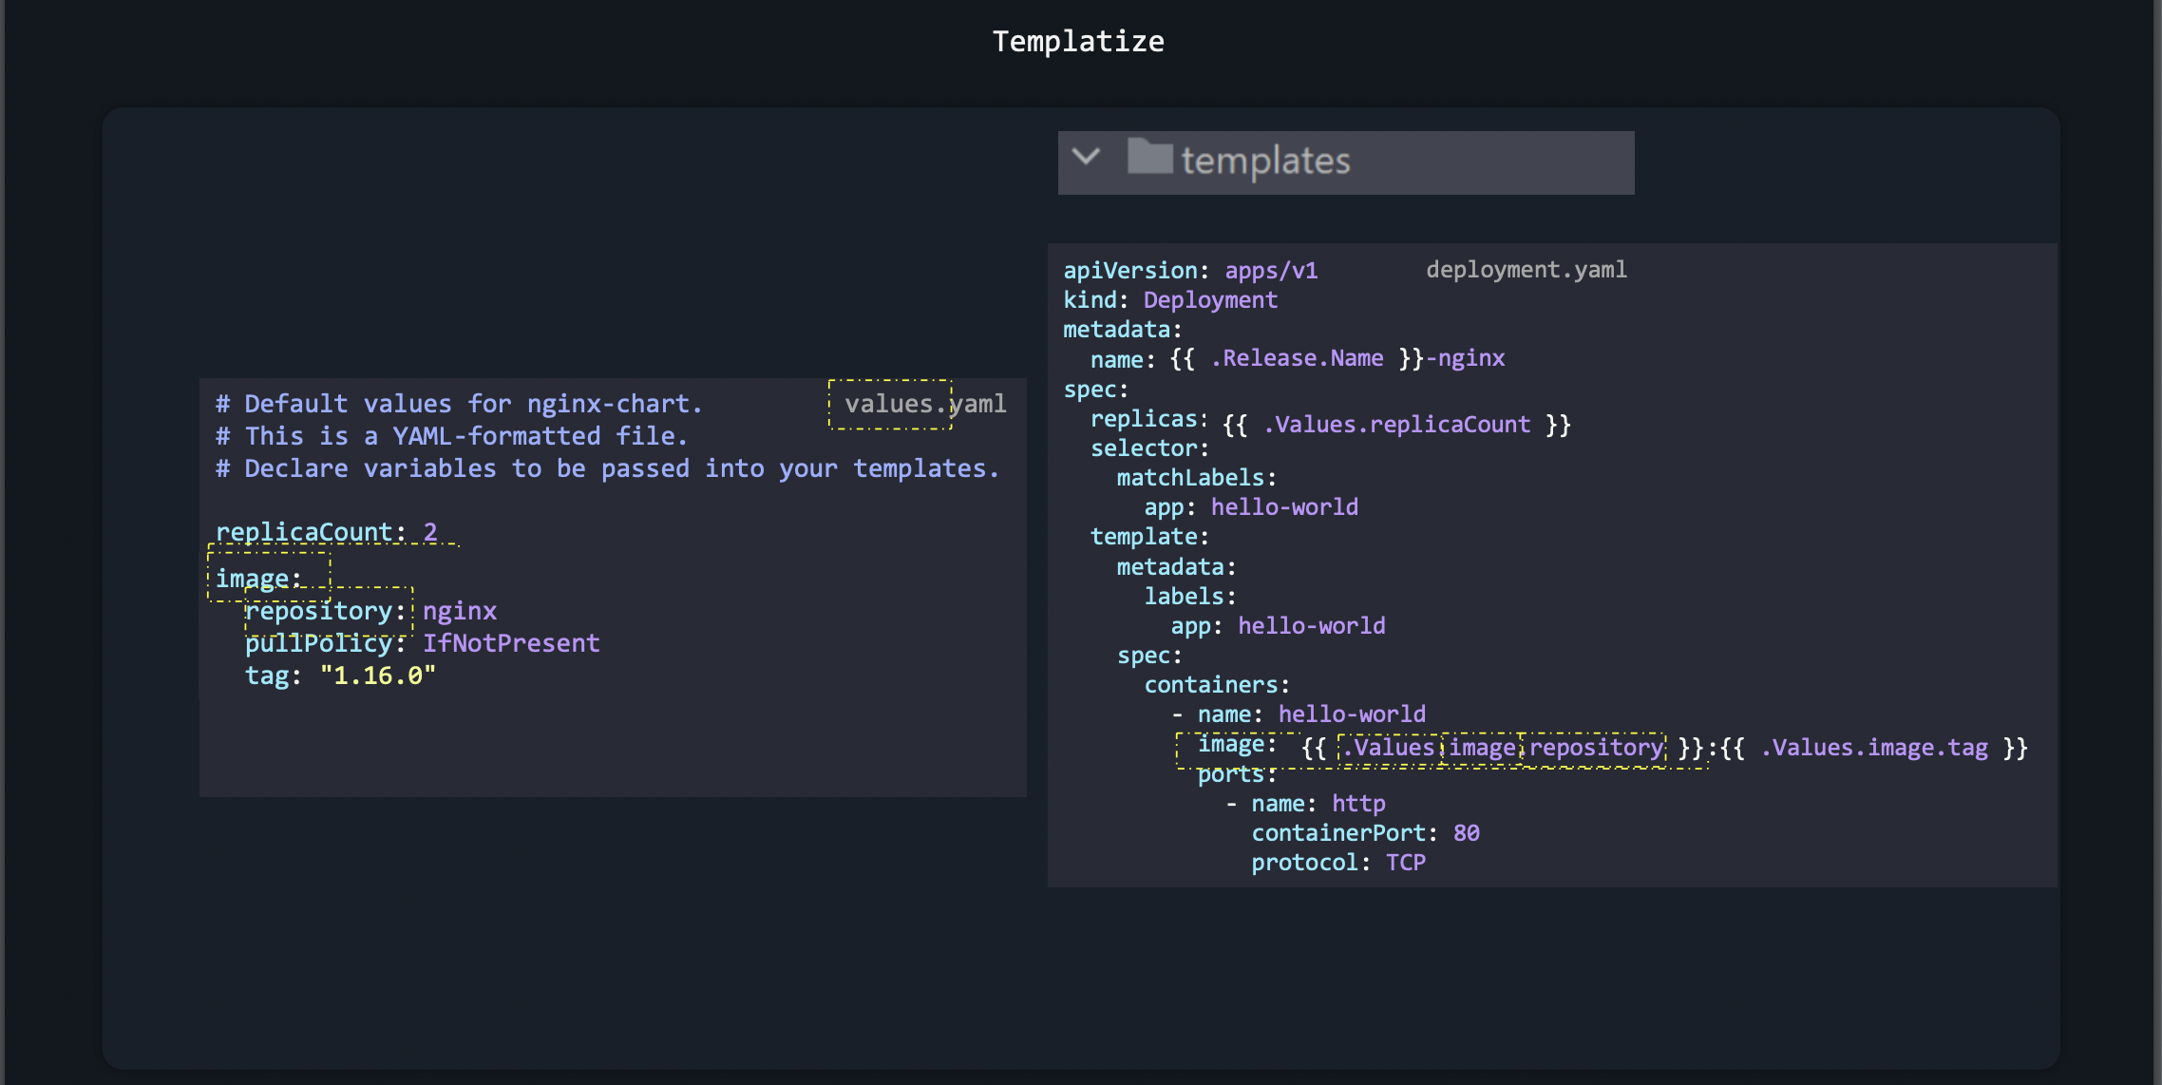

Slide 55
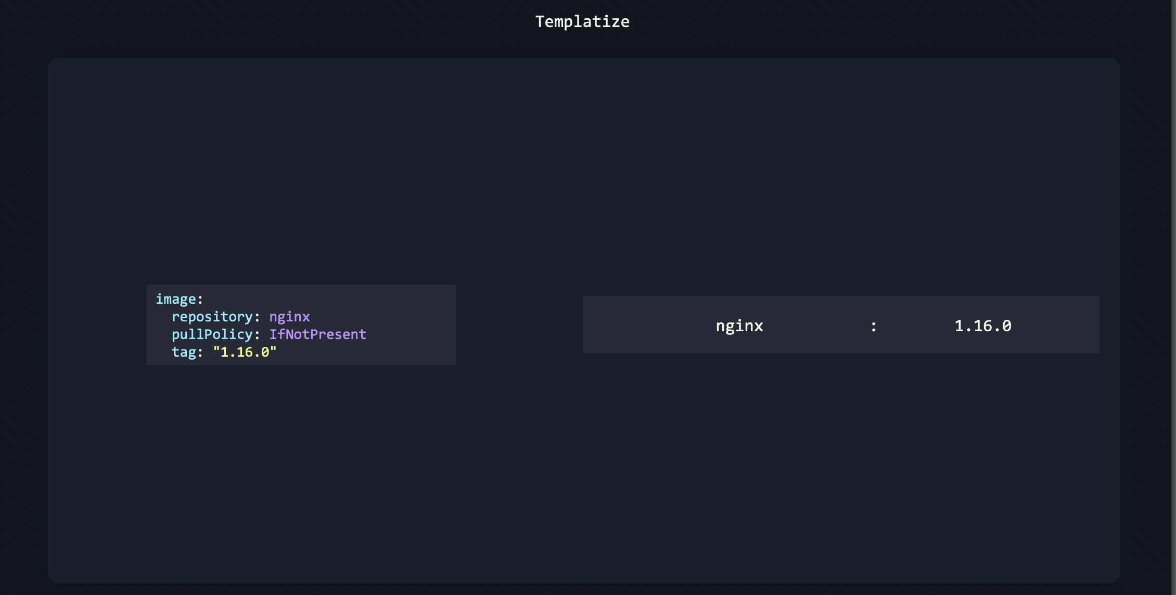

Slide 56
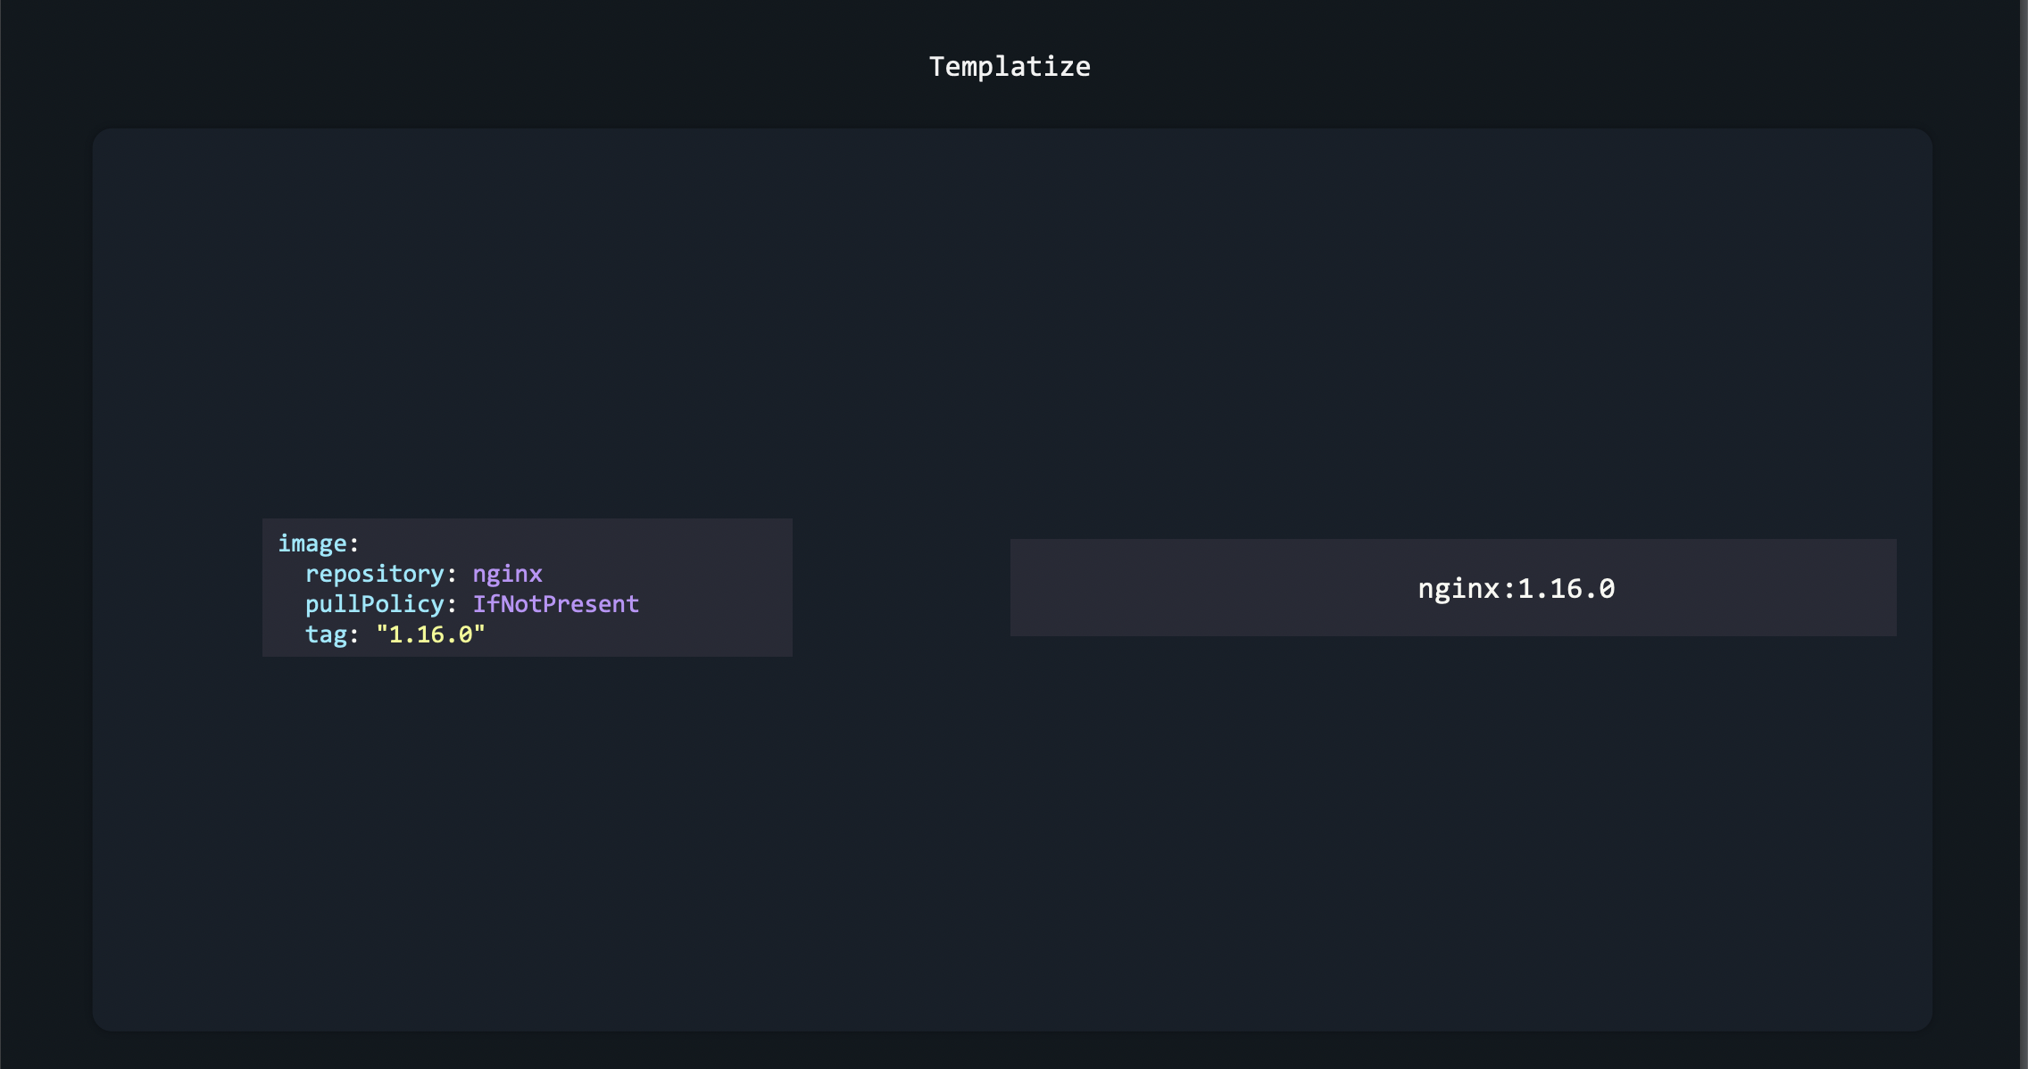

Slide 57


Slide 59


Slide 60


Slide 61

1-lint

Slide 62

2-templete

Slide 63


Slide 64

3-dry-run

Slide 66

Functions

Slide 67


Slide 68


Slide 69


Slide 70


Slide 71


Slide 72


Slide 73


Slide 74


Slide 75
PipeLines

Slide 76


Slide 77


Slide 78


Slide 79


Slide 80


Slide 82
Conditionals

Slide 83


Slide 84


Slide 85


Slide 86


Slide 87


Slide 88


Slide 89


Slide 90


Slide 92

With Block

Slide 93


Slide 94


Slide 95


Slide 96


Slide 97


Slide 98


Slide 99


Slide 100


Slide 102

Ranges:-

Slide 103


Slide 104


Slide 105


Slide 107


Slide 108


Slide 109


Slide 110


Slide 111
Lab1:-
1-Add bitnami helm chart repository in the controlplane node.
2-Deploy the Apache application on the cluster using the apache from the bitnami repository.
Set the release Name to: amaze-surf
3-Uninstall the apache chart release from the cluster.
4- install specfic version of nginx 1.22.0
, then update it to specfic 1.23.1
, then rollback

Slide 112
LAB2:-
Build web nginx app have index.html as configmap , also have service account ( if provided the value in values file),create node port service and run on port 30310,
Also this should have PV hostpath, PVC , make sure you r using functions + loops +conditional , also make sure that all in webapp namespace

